Slide 1
Practical considerations when collecting OPM data
Teresa Cheung, PhD
Fraser Health Authority & Simon Fraser University
Notes:
17:15 Teresa Cheung
15 minutes
(5) What information do you need to record in the experiment that might be automatically included in the cryoMEG?
Teresa Cheung (15 min)
coregistration, what do you need to record,
source localization
calibrations, the crosstalk, the co-registration, the sensor positions, coil definitions,
noise covariance(sensors move from reference scan)

Slide 2
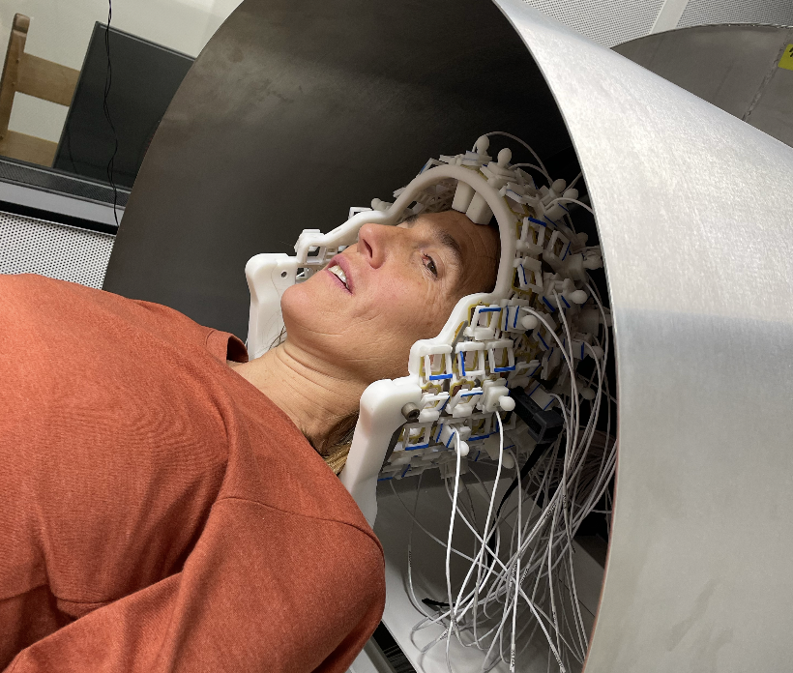
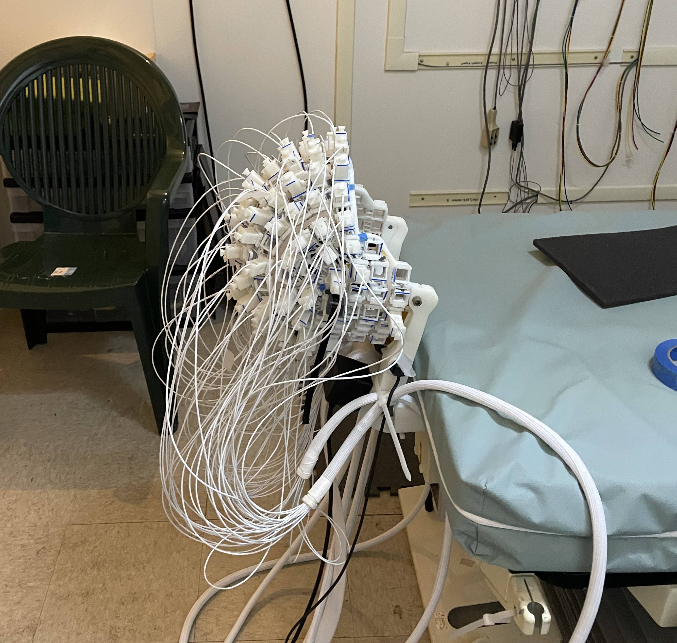
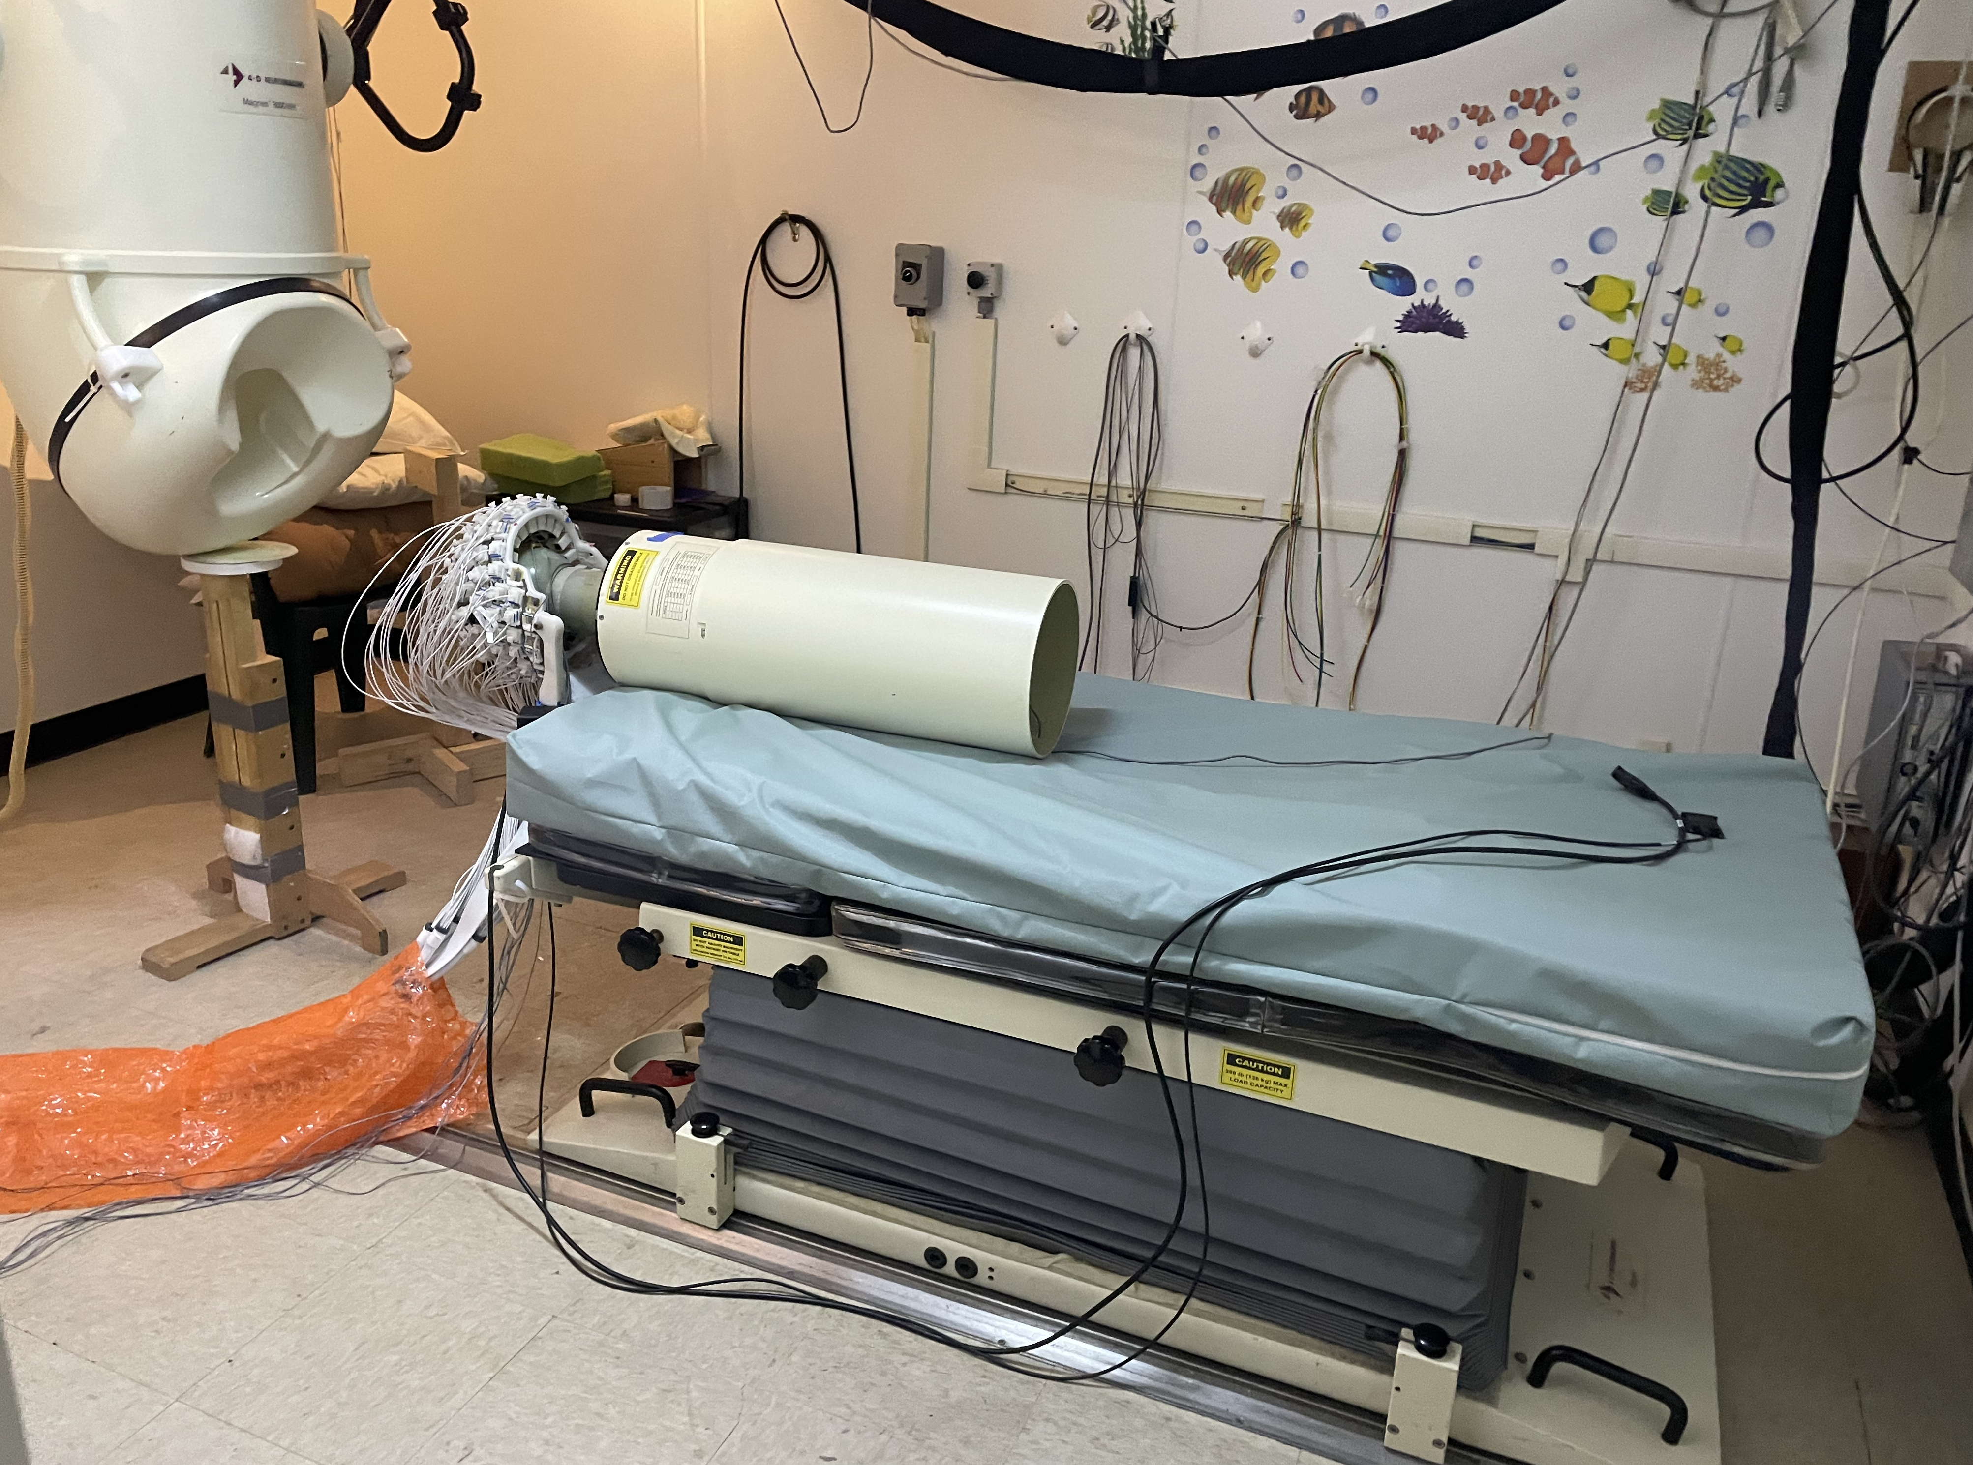
Participant setup
If the sensors are moveable, reseating them could take longer if you have to take the participant out
Setup is a little different and may be a little longer but still a lot shorter than EEG!
Notes:
You saw Bill’s arch setup at CHOP with a CTF SQUID system. Here is another example of the HEDscan system installed in an existing MEG facility. This MEG facility has a BTI SQUID system and a bed setup.
The HEDscan system is mounted to the existing BTI bed.

Slide 3
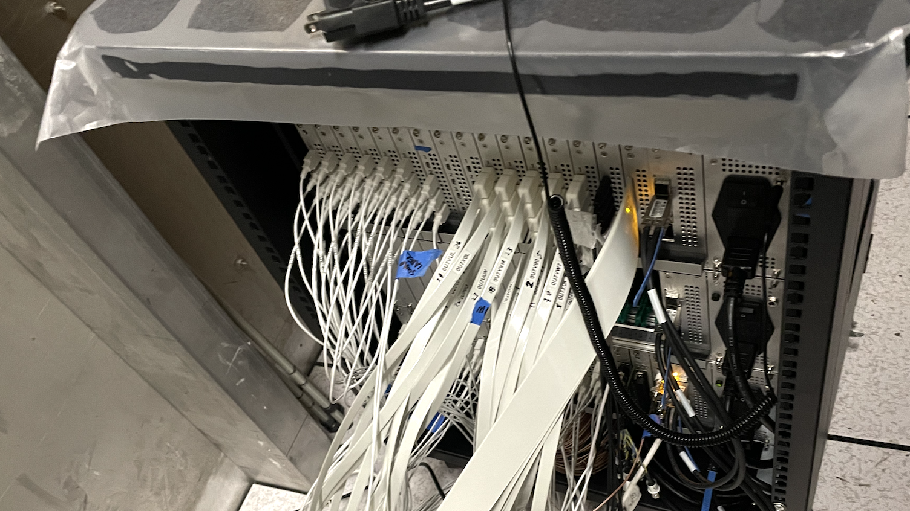
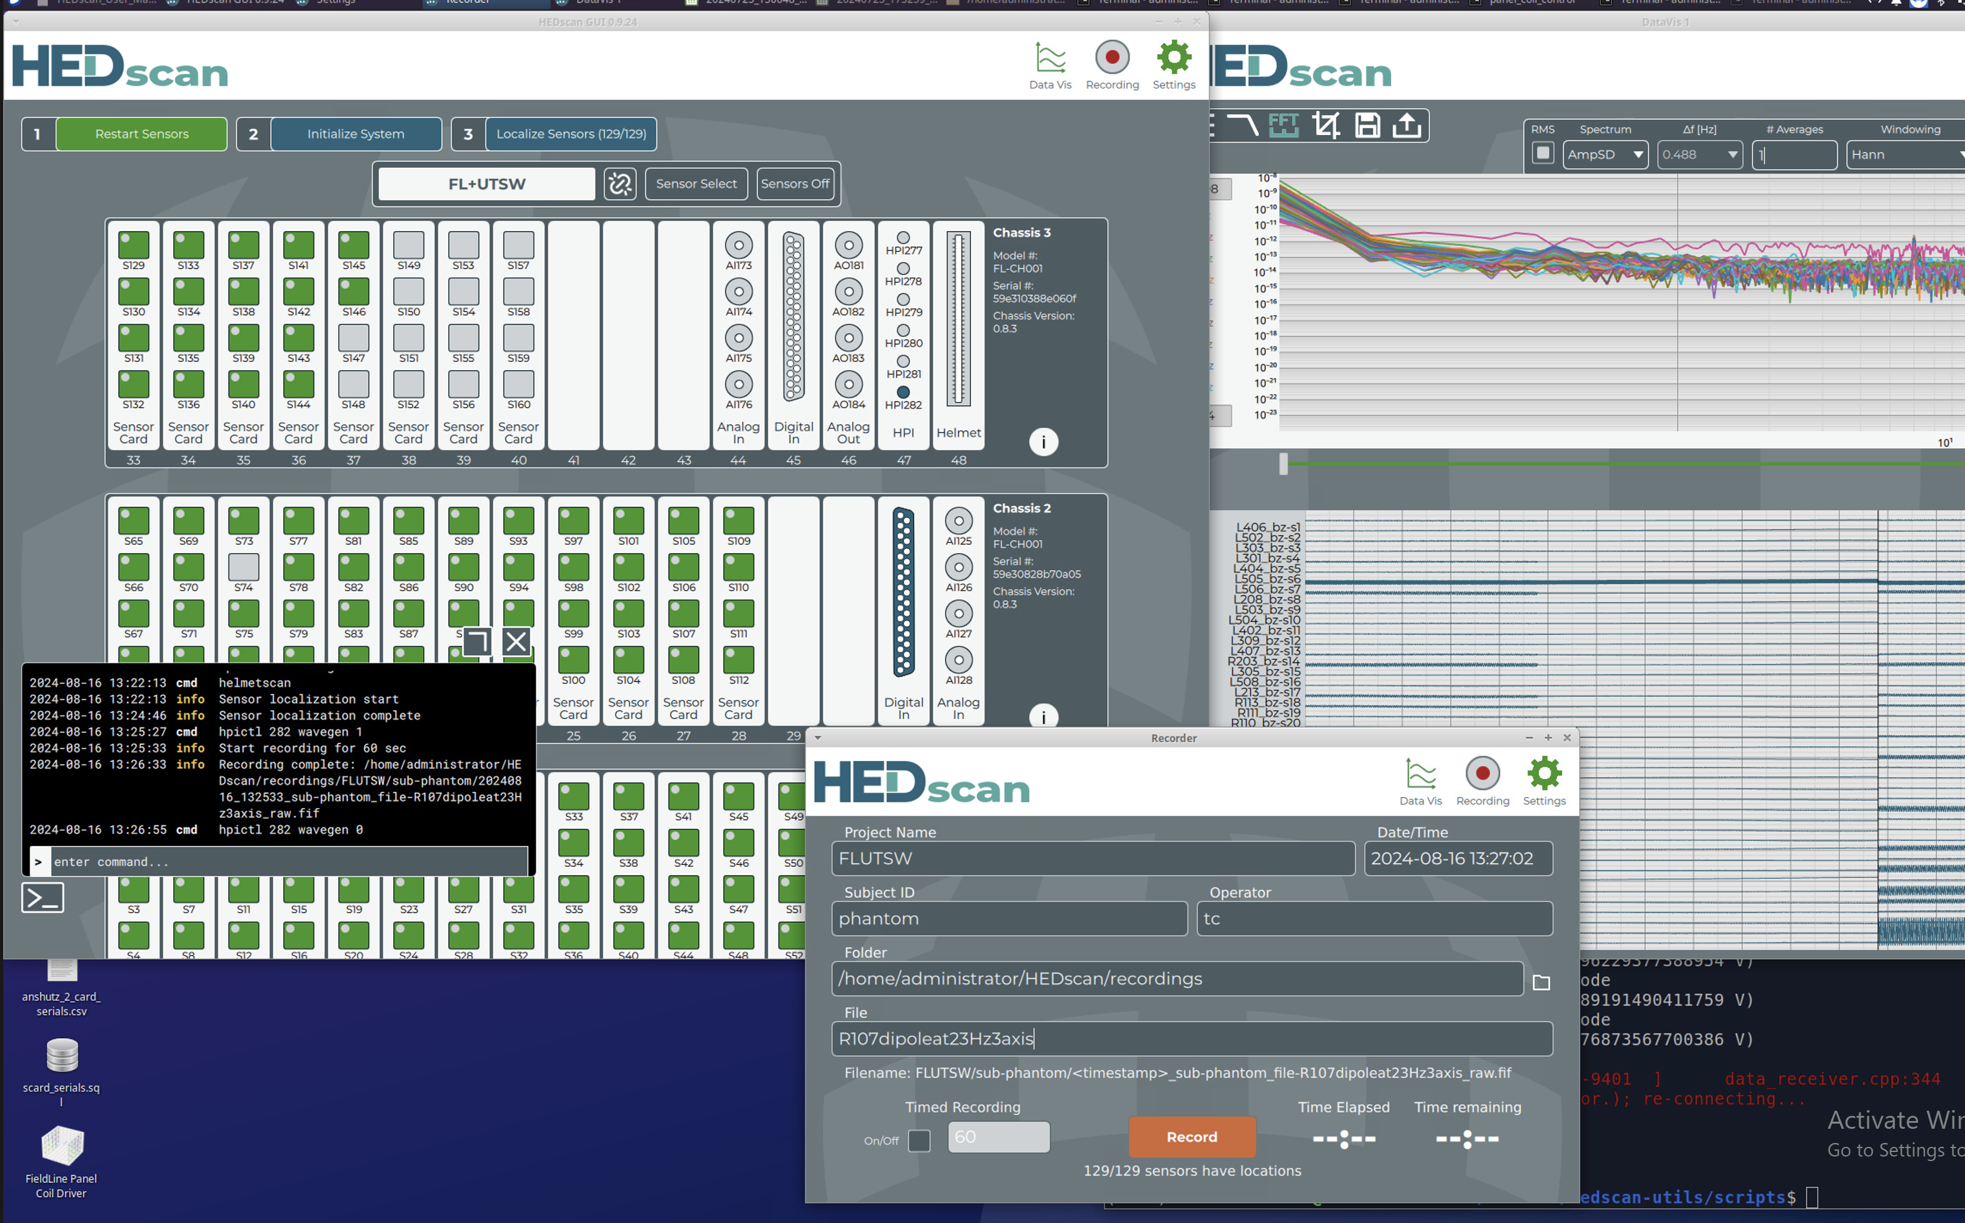
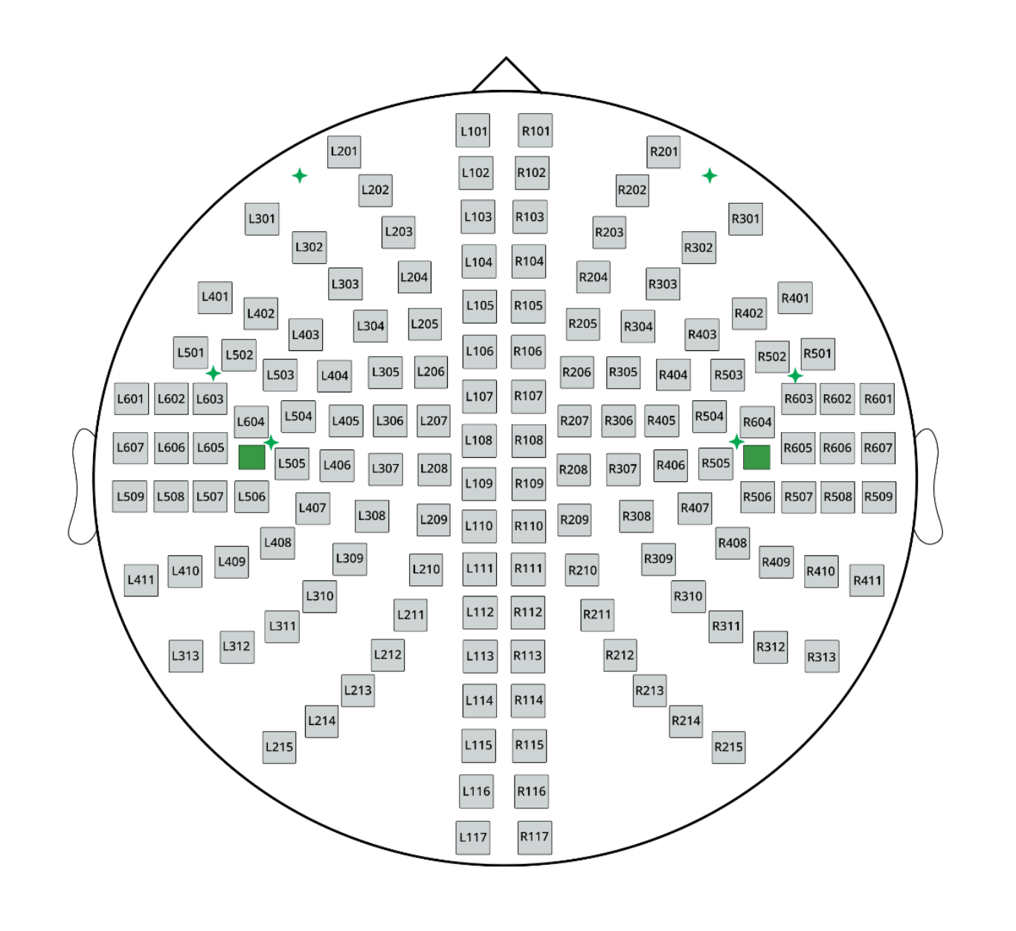
Sensor positions/coil definitions
Data collection
In Cryo-MEG, these are fixed and pre-digitized at the factory
OPM helmets may have fixed sensor positions and orientations, or they may vary from scan to scan
  This could be a result of helmet designs that allow the sensors to conform to head shape
  In the case of scalar sensors, this could be a change in the direction of the bias field (scalar sensors are directed along the direction of the bias field, e.g. earth’s field)
Sensor locations need to be determined frequently
– optical scanning, physically measuring them, digitizing
- Localizing using some kind of coil configuration
Sensors may have different labels
Refer to location they are plugged into the electronics
Location in helmet
Their serial number

Slide 4
Sensor positions/coil definitions
Data collection
Software available for MEG analysis may not be naturally set up to handle some of these differences
In some cases, the location of a sensor cannot be found – so some sensors may not have valid locations
  Could lead to problems with topologies, even if you mark the sensor as “bad”
  delete the sensor or include exclude bad in topology scripts
mne and fif format: the ”baseline” direction is defined in the coil definition file which assumes this baseline does not change from run to run, when the baseline can change from run to run, such as in the case of scalars, work-arounds need to be considered to accommodate.

Slide 5
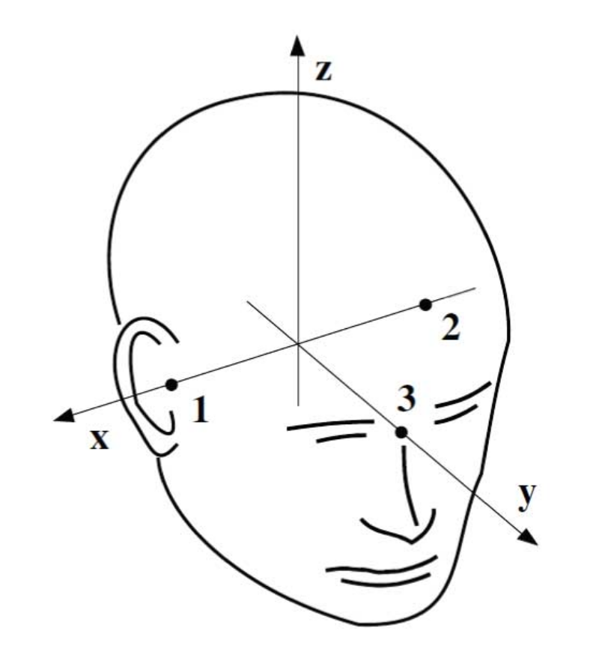
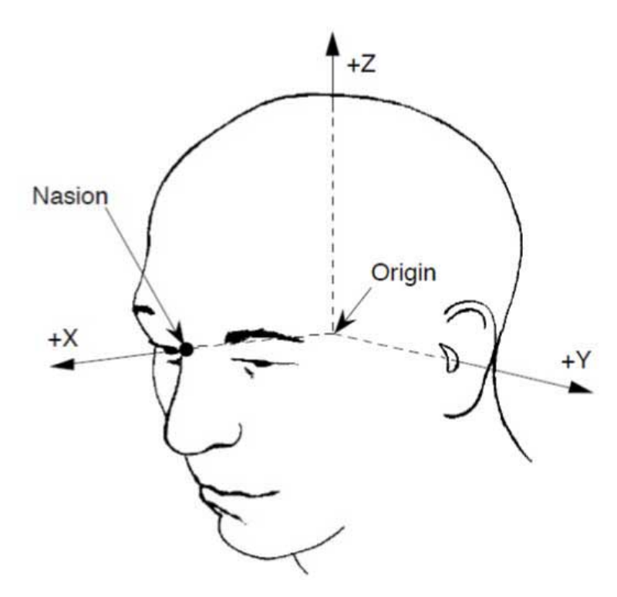
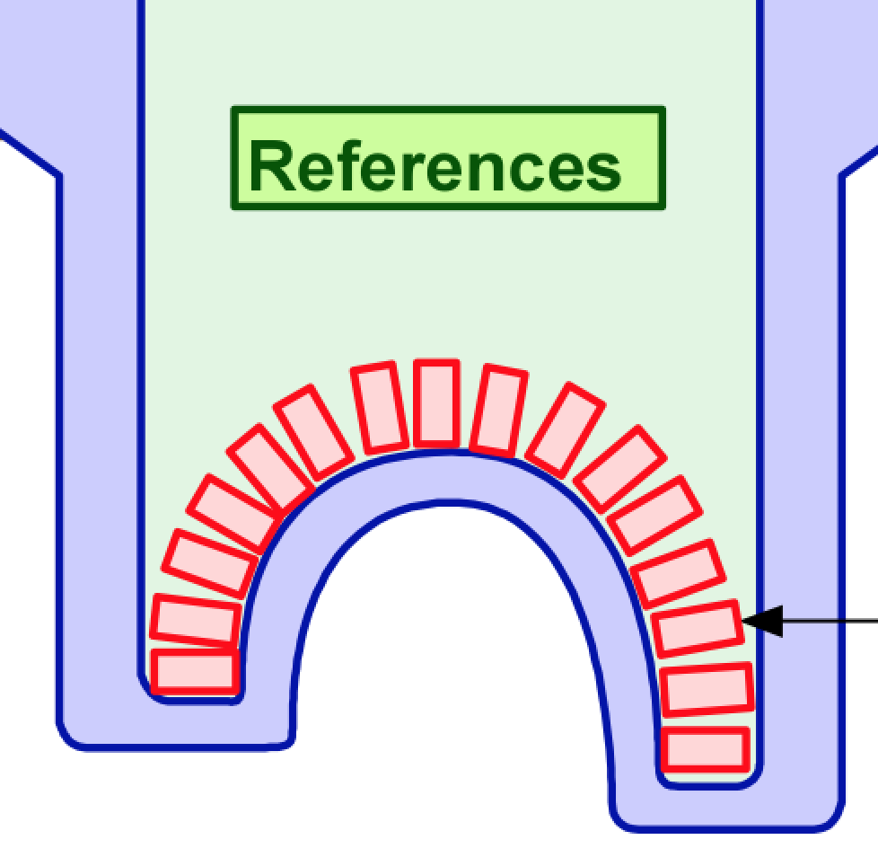
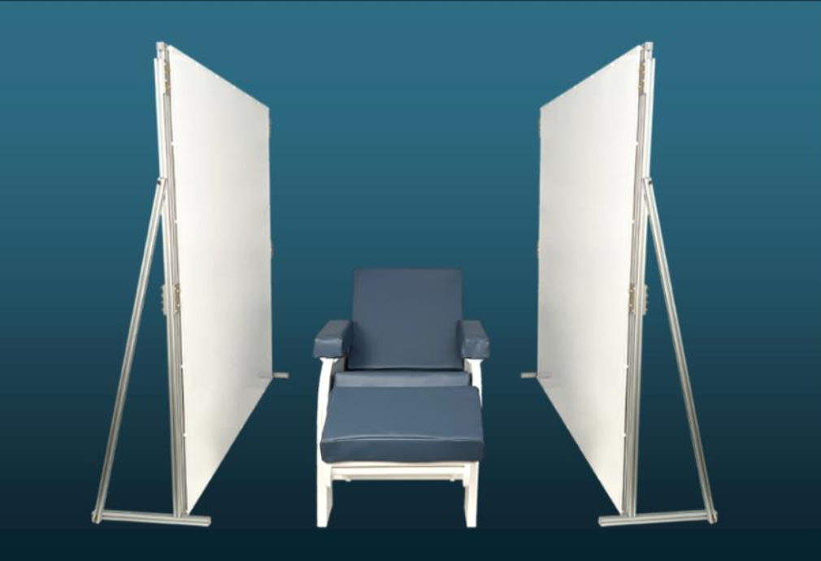
Coordinate frames
Fixed to the head
Fixed to the device because the head can be anywhere
Fixed to panel coils or room – location of helmet wrt to the coils or room to track movement
MEGIN -> fif files
4D/BTI/CTF
CTF Dewar/device coords
Head coords

Slide 6
Coregistration
two prevalent philosophies in cryo-MEG:
  Place the hpi coils anywhere and use a digitizer to define the fids
  Place the hpi coils exactly on the fids
OPM’s have a wider array of co-registration options
  Hpi
  Digitize reference points on helmet and on person and then coregistering to a second digitization of the person with fid locations (this is because you can’t always reach the fids when the person is in the helmet)
    Using traditional digitizers like Polhemus (where do you place the transmitter/receiver, can it be permanent without interfering with sensors?)
    Using Optical scanners
even with the sensors conforming to head surface, the person can move between runs
  Invalidates your careful digitization before or after the data is collected
  Some kind of tracking of head position between runs without having to go into the MSR may be necessary
  Unless you can optically track the head in 3-D within the helmet, the use of HPI’s seems necessary to check head position between runs (or continuously).
Notes:
Use of hpi coils
Other techniques such as optical scanning
Can the optical scanning be done in real time during scanning?
Whatever is done, it is important to be able to check head positions without having to go into the MSR

Slide 7
But what if you only have a few sensors?
HPI’s might not localize -> perhaps we need to be clever with the algorithms -> minimum of 6 sensors to locate an hpi
Place HPI’s in locations near the sensors and digitizing fids separately
Optical solutions? (how precise can they be?)

Slide 8
Recording hpi’s
Unlike cryo-MEG there is a limited frequency range approximately < 300 Hz
Selecting appropriate frequencies in this range (separate by power line frequency is a good idea if they are being activated simultaneously)
If in open loop – cross axis effects – so the signals should be small < 1 nT
May be better to collect hpi sequentially if there is risk of cross axis effects from the other coils being activated (but there will still be effects from the primary coil)

Slide 9
Single precision data formats may not be good enough for OPM data
Saving the data
Digital data is quantized -> when the numbers are small you run into digital noise
Many of the Cryo-MEG file formats are single precision
  Fif – as a single precision float (?)
  CTF as a single precision int and converted to a float using something called a QGain (which fixes the number of decimal places -> this causes railing if your numbers are too big)
Notes:
Removing offset will help with fixed precision formats
10^-6, 1 fT
28 bits
Mantissa
10^-6 phi0
.1fT
100 nT
10^-9
10^-(9-8)
+/-1 ex

Slide 10
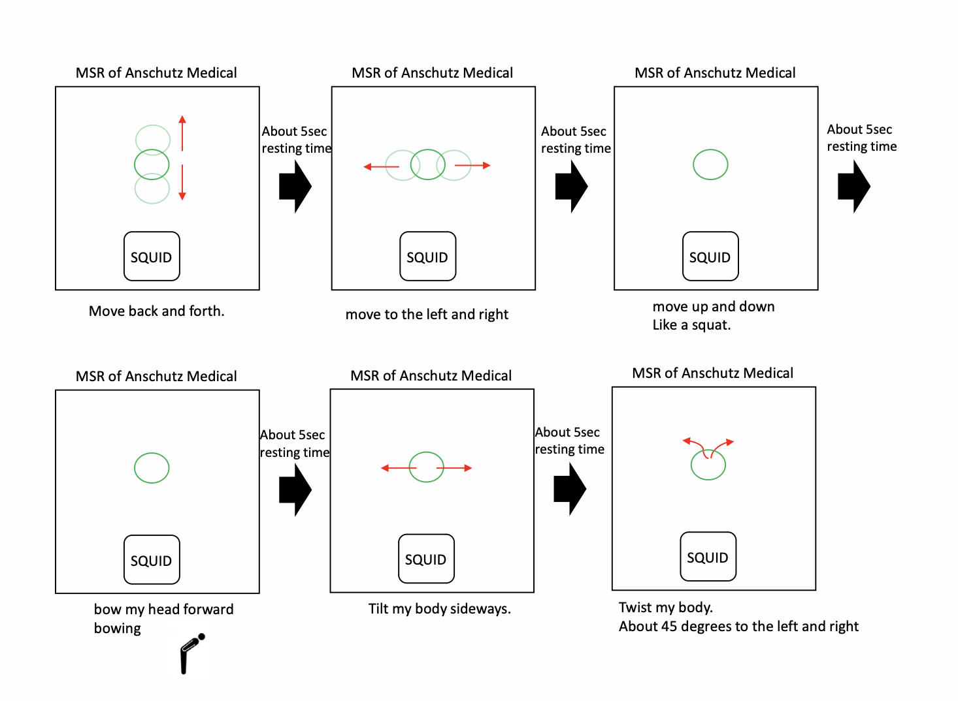
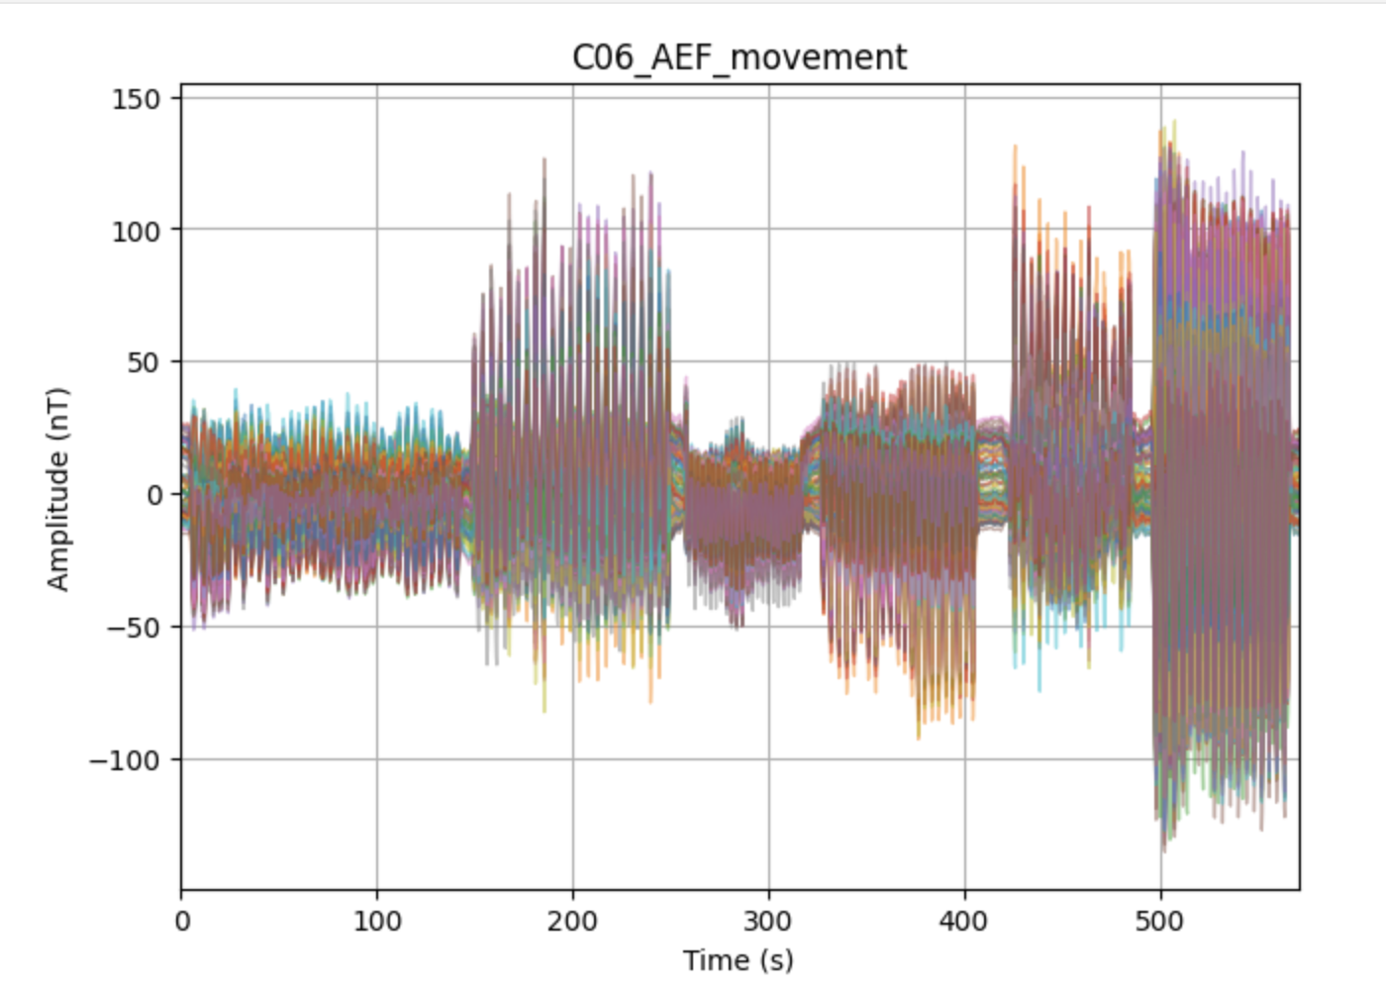
Single precision data formats may not be good enough for OPM data
I have participated in measuring MEG in Earth’s field and even within a shield, I have observed swings around +/- 150 nT.
The participant was standing and asked to do some random movements from 0 to 150 seconds.
Then the participant was asked to do some specific movements – repeating the same action for about 40 repetitions pausing and then doing a different set of repetitions.

Slide 11
Single precision data formats may not be good enough for OPM data
Let’s see smallest decimal place a single precision number could achieve if we start with a signal at 150nT
Let’s assume we save in single precision float = 32 bits
1 bit = sign
8 bits = exponent
23 bits = mantissa (decimal part)
The exponent part tells us the range of numbers we can have which roughly range between 1e38 to 1e-38
BUT, the precision is dictated by the 23-bit mantissa, which gives you roughly 7 decimal places of precision.
EXAMPLE: if you have 150 nT = 150 e-9 = 1.5 e-7 -> 1.5e(-7-7) = 1.5e-14 = 15 fT
So the digital noise is around the noise floor of an OPM sensor if we have swings in the data that reach 150nT.
Notes:
Fixed point representation
Floating point representation
Mantissa – 7 decimal places
Exponent – gives you a range of numbers you can represent from –10^-38 to 10^3
BUT this is not the precision of the number
EXAMPLE if you have a value = 1e38, the smallest number before you run into digital noise is 1e(38-7) = 1 e31
So if you have want to resolve 0.1 fT (which I think is the resolution of the CTF format), then 1e(-16+7) = 1 e -9 -> 1 nT is the biggest field we should measure

Slide 12
Single precision data formats may not be good enough for OPM data
If the data swings are too big, the data may rail (fixed precision), or you introduce digital noise (floating point)
Be aware of the size of the signals. You may see increased noise in your data as a result of the higher digital noise.
Message to the MEG software programmers: Perhaps we should adopt saving double precision data (MNE has this option)

Slide 13
Source localization
Data analysis
Sensors are in head coordinates.
Coordinates of conductor model is in head coordinates.

Slide 14
Noise covariance
Noise covariance is used to spatially whiten the data to suppress between-sensor-correlations in the noise and applied prior to source modeling
In the case of evoked data, you could collect some additional “resting” data by incorporating a longer baseline or a rest block during the evoked data collection
In the case of resting data, the empty room noise covariance is used
Cryo-MEG – the sensors have a fixed location
OPM channels and the helmet can be spatially different than when an empty room noise was collected.
?? So, what should we use for noise covariance in the case of resting data?
  ? Estimate sensor noise and provide a diagonal matrix (SAM Beamformer does this)
Notes:
To improve data with regard to these requirements a spatial whitening step is commonly implemented that allows to suppress between-sensor correlations related to noise. More specifically, a spatial covariance of the additive noise is estimated from data and subsequently used for whitening. This transforms data into independent white noise vectors characterized by an identical variance across channels.

Slide 15
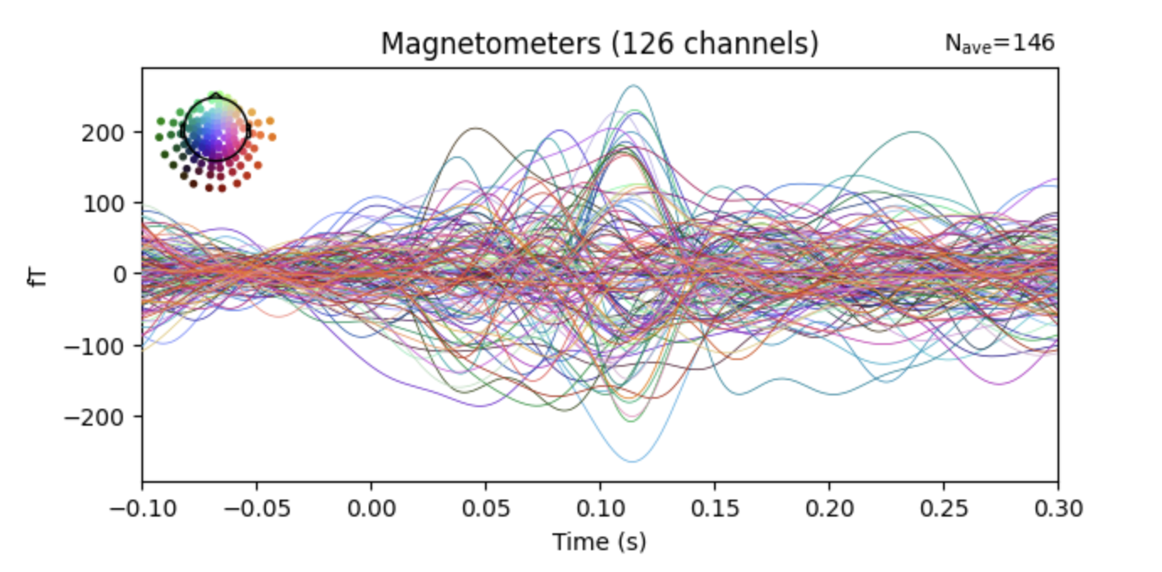
AMM compared to 70 projector SSP (3.5 hz to 20 Hz)
SSP with 70 projectors
AMM – 5 Hz high pass
+/- 50 nT signals
AMM = Adaptive Multipole Models
Notes:
AMM = Adaptive Multipole Models

