Slide 1
How to set up your OPM-MEG experiment for success and what to consider when analyzing OPM data
Robert Oostenveld
robert.oostenveld@donders.ru.nl
Notes:
For those that do not know me, I am …

Slide 2
Outline of this talk
Sources of noise in EEG, SQUID-MEG and OPM-MEG
Dealing with noise in hardware and during offline analysis
Difference in OPM and SQUID procedures
Data formats and BIDS
Processing of OPM data

Slide 3
Advantages of OPMs over SQUIDs
No cryocooling needed.
Each sensor in its own small housing.
Flexible placement in a helmet or cap directly on the scalp.
Relatively light-weight, allows MEG recordings while moving.
OPMs combine the advantage of MEG with the advantage of EEG.
SQUIDs
OPMs

Slide 4
Noise in EEG recordings
Physiological
Due to brain sources that are of no interest
Due to eye movement
Due to muscle activity, including the heart
Sweating
Behavioral noise
Due to the movement of the electrode (and gel) relative to the scalp
Environmental
Electrostatic noise from other equipment, e.g., computer screen
50 or 60 Hz line noise
RF noise (e.g., from a cell phone or other radio)
Instrumentation
Saturation of the amplifier and clipping
Large “common mode” signals both on the electrode of interest and its reference

Slide 5
Noise in SQUID-MEG recordings
Physiological
Due to brain sources that are of no interest
Due to eye movement
Due to muscle activity, including the heart
Behavioral noise
Due to small magnetic particles that move with the participant
Environmental
Magnetic noise from other sources, e.g., cables going into the MSR, nearby elevators, etc.
50 or 60 Hz line noise
The MSR vibrating in the residual earth magnetic field
Instrumentation
Non-linear transducers
Quantum flux (or SQUID) jumps

Slide 6
Noise in OPM-MEG recordings
Physiological
Due to brain sources that are of no interest
Due to eye movement
Due to muscle activity, including the heart
Behavioral noise
Due to small magnetic particles that move with the participant
Environmental
Magnetic noise from other sources, e.g., cables going into the MSR, nearby elevators, etc.
50 or 60 Hz line noise
The MSR vibrating in the residual earth magnetic field
The OPMs moving in the residual earth magnetic field
Instrumentation
Non-linear transducers
Large fields, sensors unlocking

Slide 7
How is noise dealt with in the case of EEG?
Prevent it during the recording.
Short-lived transient bursts of noise can be rejected from further analysis. For example, in an experimental design with 100 trials, you cut the data in segments and only keep those trials in which the EEG data is good.
Artifacts that are continuously present cannot be rejected that way, as that would remove all data. Hence we remove it from the EEG data by subtraction.
- Linear regression of ocular artifacts (Gratton et al. 1983)
- Principal Component Analysis (PCA, Brown et al. 1979, de Cheveigné & Simon 2007)
- Independent Component Analysis (ICA, Makeig et al. 1997)

Slide 8
How is noise dealt with in the case of EEG? -> Preventing noise
EEG electrode material (Ag/AgCl) and matching gel as electrolyte.
EEG amplifier design, including a REF and GND electrode, or a DRL and CMS.
Placement of the reference and ground electrodes (on the head, not on the torso).
Skin preparation to stablize and reduce the impedance.
Short cables.
Active electrodes.
Making the whole EEG lab into a Faraday cage; this is also useful for acoustic shielding, so that your participant does not get distracted.
Smart choice of lighting: no fluorescent tubes, rather LEDs or tungsten.
Good instructions to the participant.

Slide 9
How is noise dealt with in the case of EEG? -> Offline data cleaning
Common to both ocular regression, PCA, and ICA is the concept of spatiotemporal mixing of the brain signals of interest with noise sources.
Noise sources are assumed to be stationary, so their topopgraphy remains the same, only their amplitude varies (and can be zero when no artifact is present).
Except for electrode movements relative to the scalp (Nordin et al. 2018), the EEG signal and many noise signals don’t change with (small) head movements.
Y = G X = G₁X₁ + G₂X₂ + G₃X₃ + ... + G_{n}X_{n}
n typically the same as the number of channels
The signal Y includes brain, but also line-noise, EOG, ECG and all other noise that is visible on all EEG channels

Slide 10
How is noise dealt with in the case of MEG? -> Preventing noise
Passive shielding of the room with layers of mu-metal and aluminium.
Active shielding with coils (constant, or time-varying).
A smart design of the MEG sensors and electronics, e.g., gradiometers and/or closed-loop operation.
Avoid movements of the participant.
Demagnetizing (or “degaussing”) the participant. No jeans, no underwire bra, …
No magnetic metal and no electric currents in close-by stimulus equipment.

Slide 11
Magnetically shielded room (MSR)
Taulu et al. 2014

Slide 12
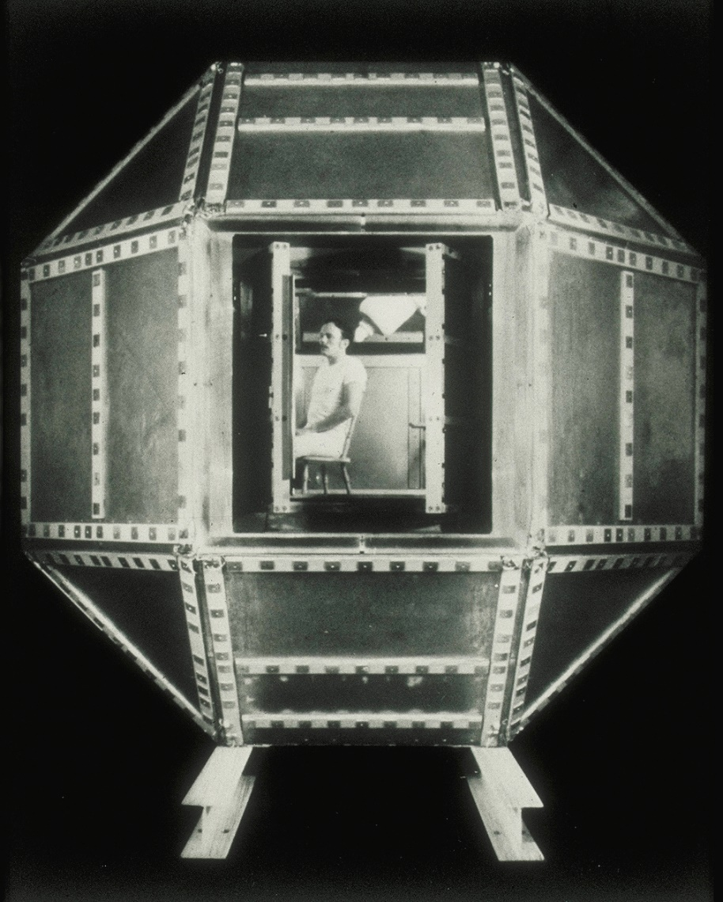
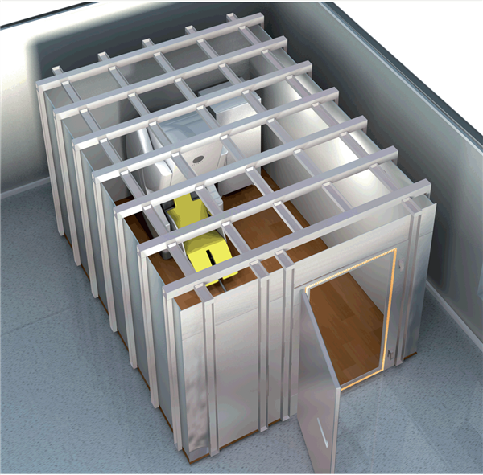
Magnetically shielded room (MSR)
The magnetically shielded room built by David Cohen at MIT's Francis Bitter National Magnet Laboratory in 1969.

Slide 13
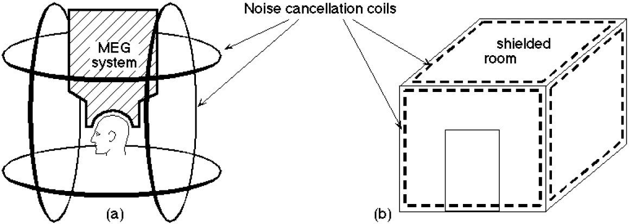
Shielding - active
Vrba, J. (2000). Multichannel SQUID biomagnetic systems. In H. Weinstock (Ed.), Applications of Superconductivity (Vol. 365, pp. 1–79). Boston; Kluwer Academic Publishers; 1999.

Slide 14
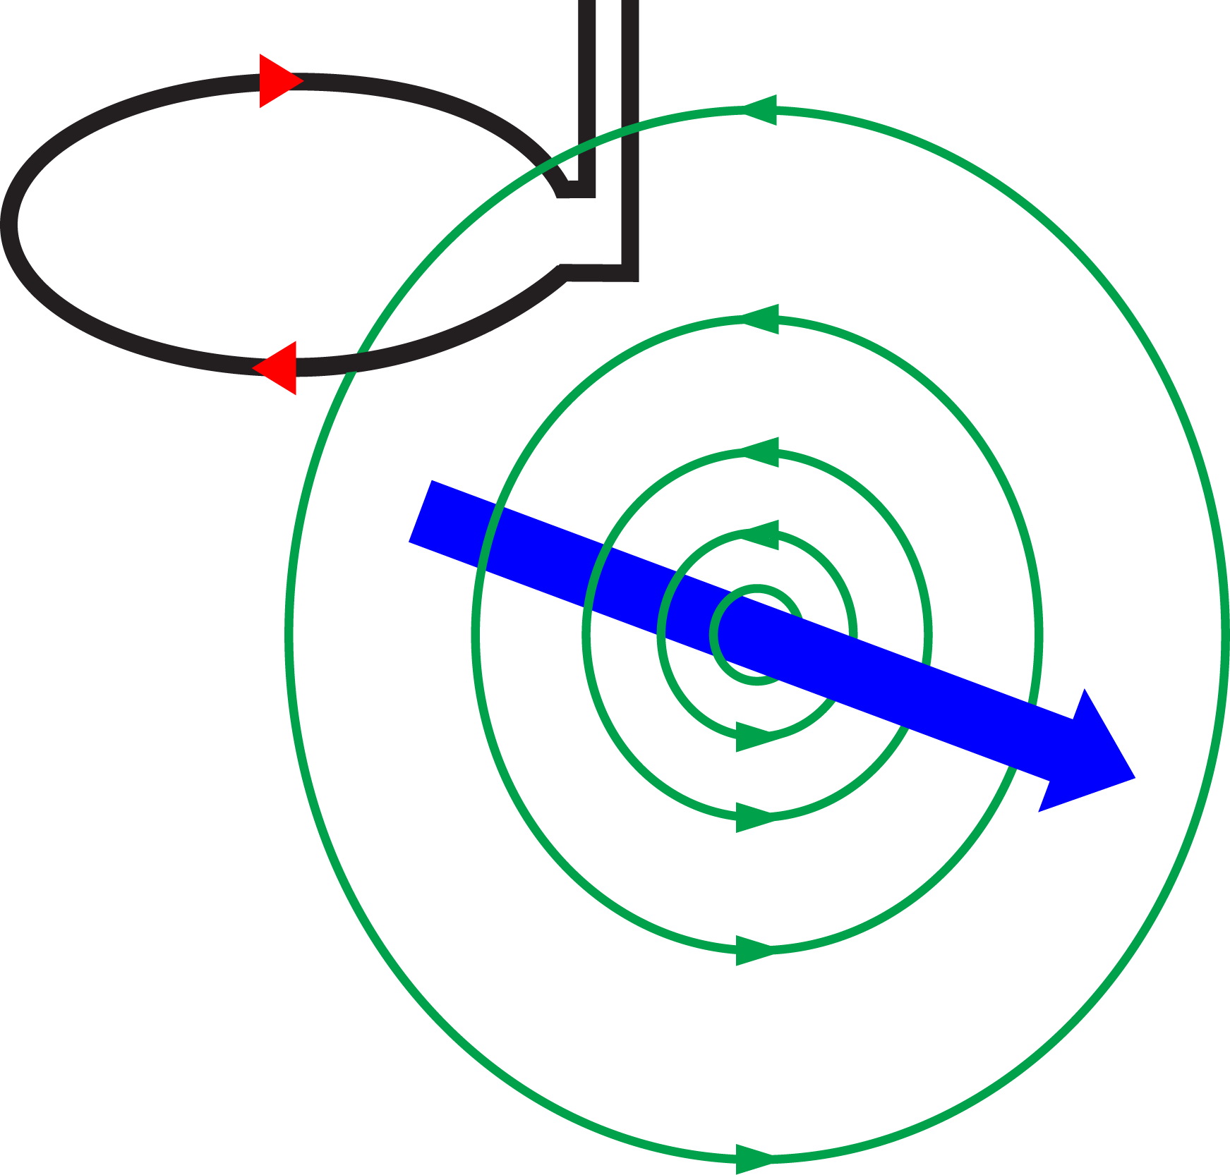
Smart sensor design - Magnetometer
Environmental noise

Slide 15
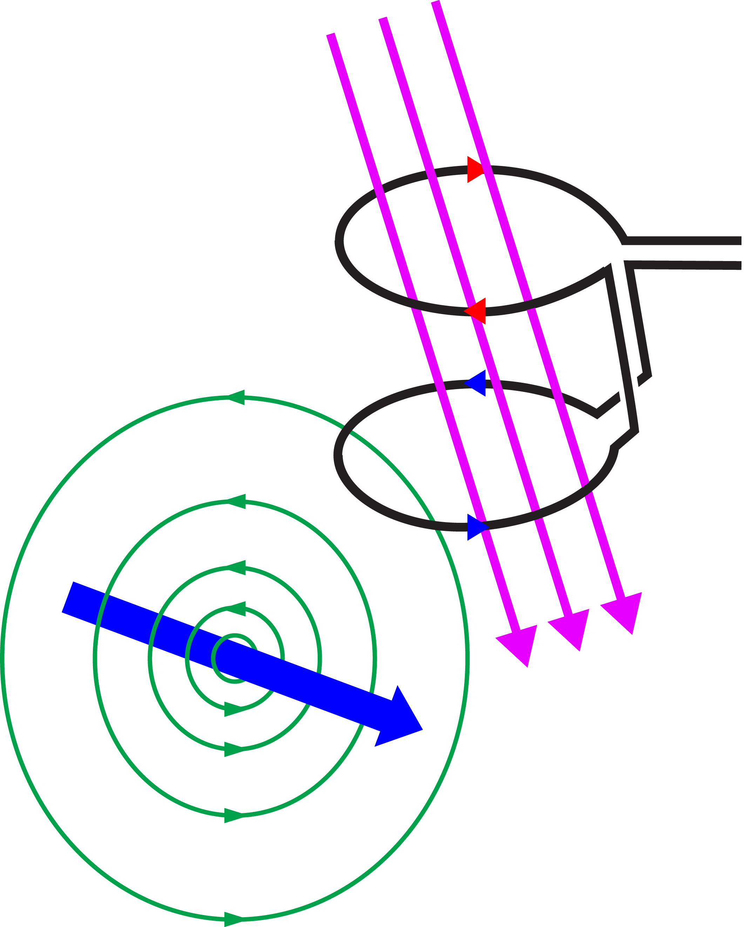
Smart sensor design - Axial gradometer
Environmental noise

Slide 16
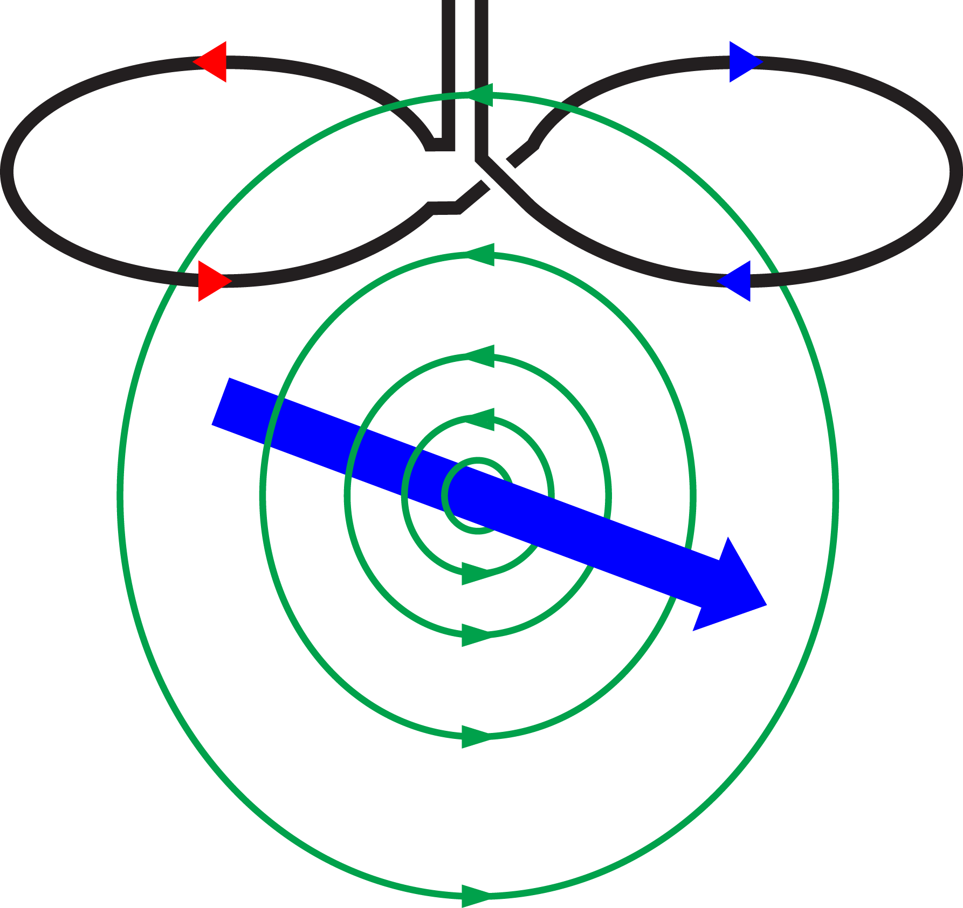
Smart sensor design - Planar gradiometer
Environmental noise

Slide 17
Reference sensors and Synthetic gradiometers
Superconductive pickup antenna’s consisting of multiple coils have a perfect noise-free subtraction between the two coils, but are fixed in their design.
Rather than building a hardware gradiometer, you can also take a sensor close to the head and subtract the signal from a “reference sensor” further away from the head. CTF and BTi/4D both make use of this.
The CTF system makes a mathematical model of the 1st , 2nd , and 3rd order gradients using the reference sensors and uses those to remove the estimated environmental noise (and spatial gradients).
The BTi/4D system uses the reference sensors to compute the correlation of their signal with that on the MEG sensors of interest, which is more similar to the Gratton ocular correction algorithm or to SSP.

Slide 18
What is the challenge with reference sensors?
If you have a few reference sensors and subtract (a linearly weighted combination of) their signal from the MEG signal, then you are also subtracting (or adding the noise). Noisy references mean that all MEG channels become more noisy.
Consider one sensor of interest (close to the brain) and one further away: their noise can be assumed to be independent and hence the difference (or gradient) is sqrt(2) times or 41% more noisy.
Solution: use not a few but all channels that you have to estimate the noise and subtract that; the noise averages out between channels. This is more similar to PCA and ICA in EEG, and this is used by Neuromag/Elekta/MEGIN.
Some methods that do this for SQUID-MEG data are SSP, DSSP, SSS, tSSS.

Slide 19
What is the challenge with head movements while wearing OPMs?
rotation
movement

Slide 20
How to deal with head movements and OPMs?
Make the overall residual background field as small as possible using the MSR (additional layers of mu-metal) and Helmholz coils.
Make the residual background gradients as small as possible. This needs more complex coil configurations, like planar gradient coils and matrix coils.
Coils outside the MSR cannot be used to remove gradients, coils inside the MSR can.
Many Neuromag/Elekta/MEGIN systems have both external and internal coils and use internal active shielding (IAS). Note that this neccessitates MaxFilter to be applies offline, see also Westner et al. (2022).

Slide 21
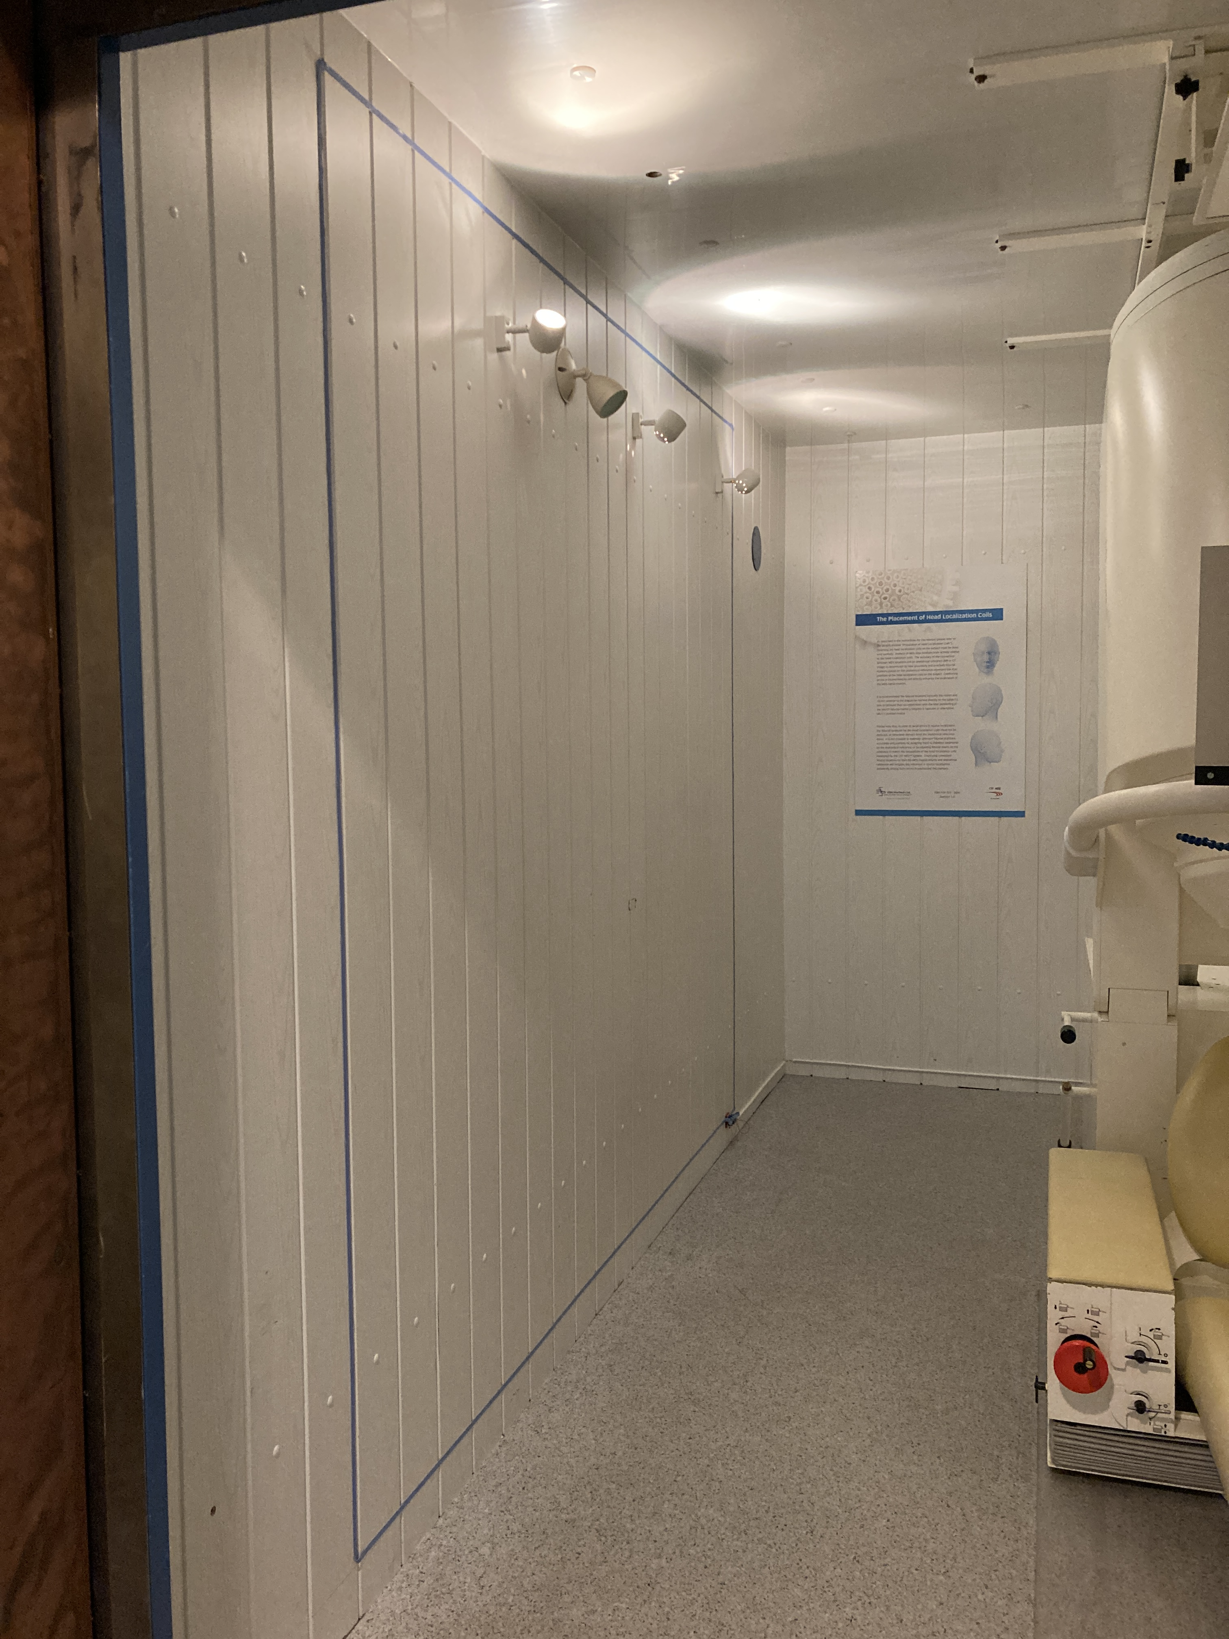
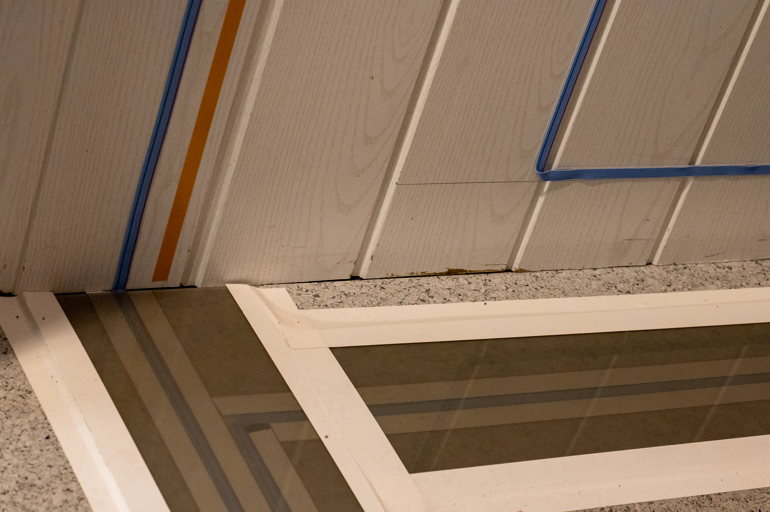
Simple Helmholtz-style coils inside the Donders magnetically shielded room
Notes:
FieldLine OPMs have sufficient dynamic range for our MSR and built-in compensation coils
Gradients are important for movements
Dynamic is important for denoising (since magnetometers)

Slide 22
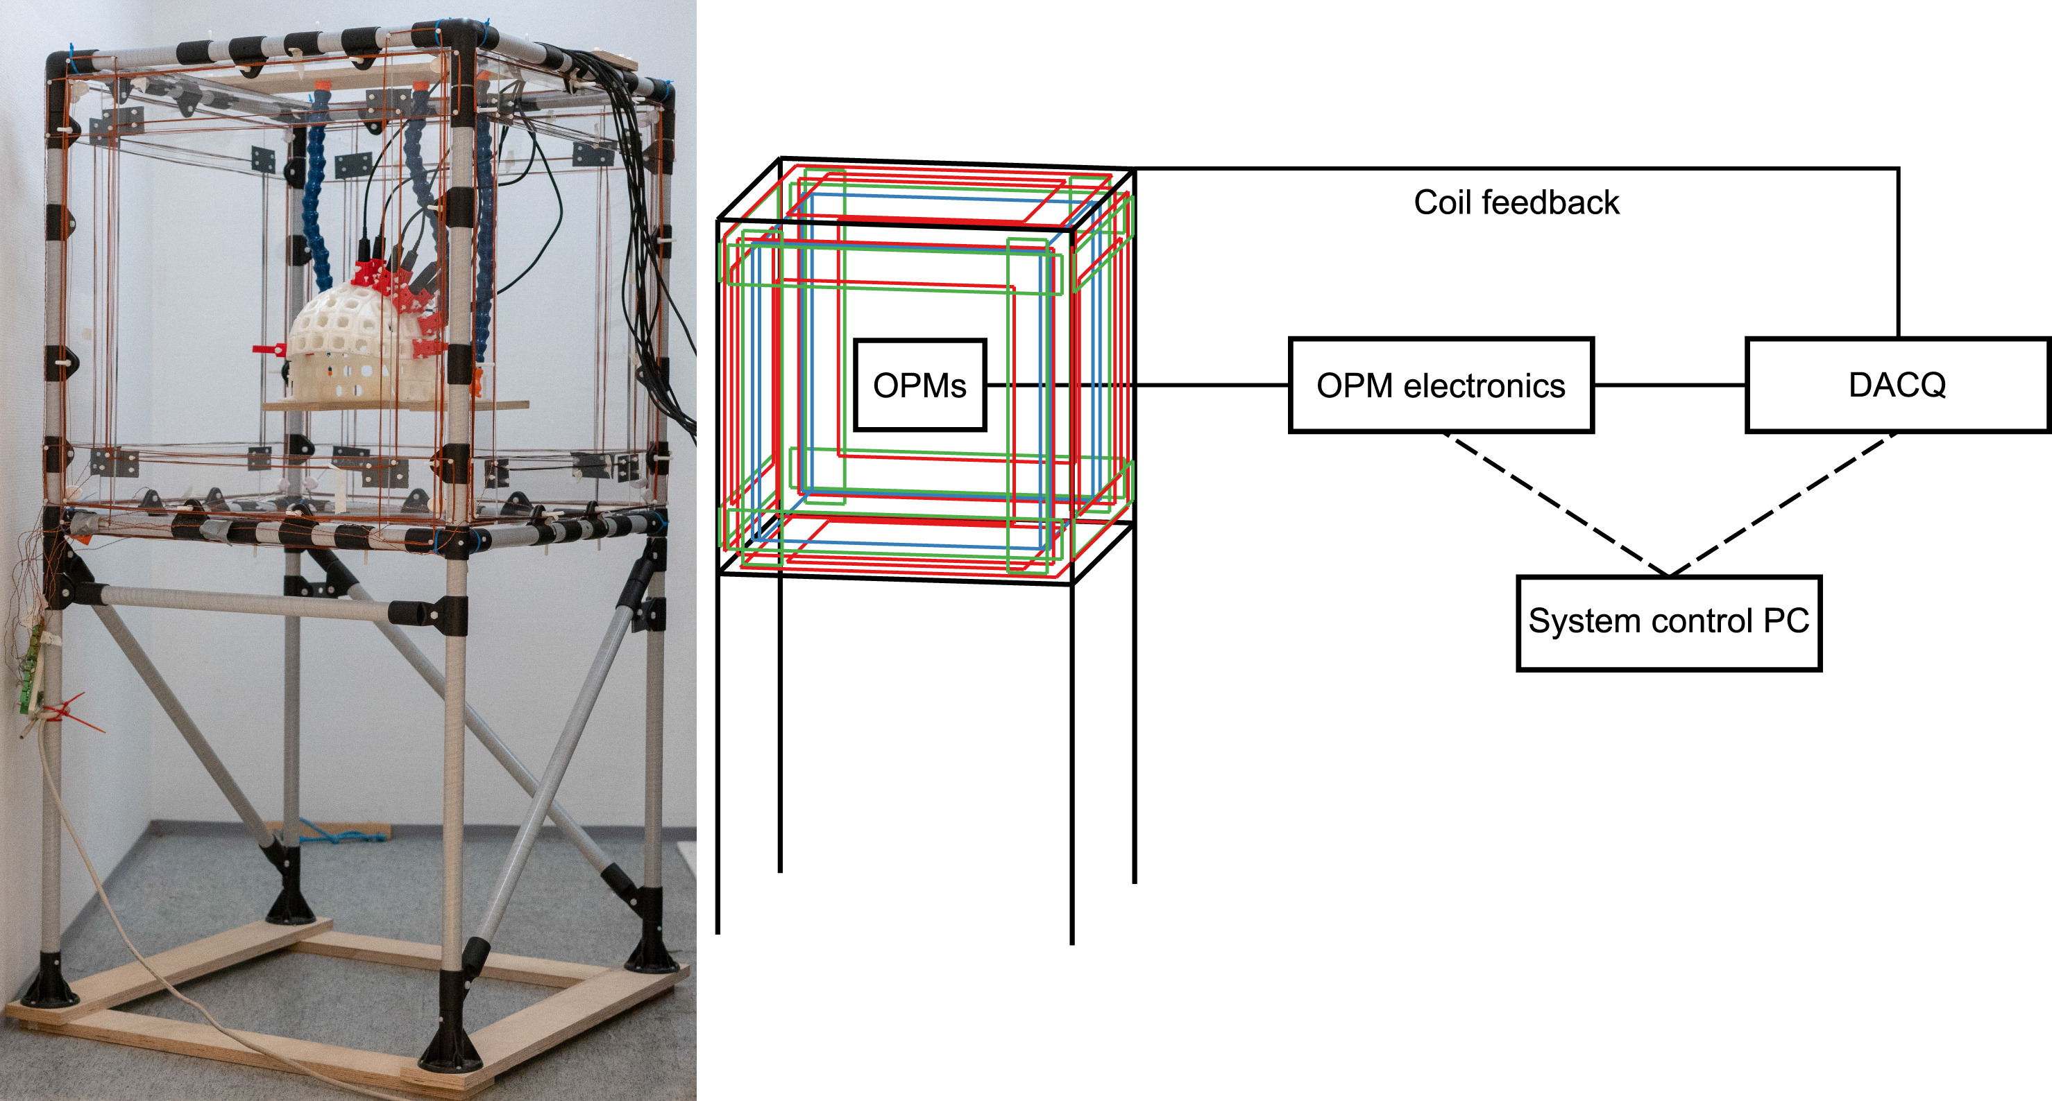
More compact design of nulling coils
Helmholtz-style coils
Iivanainen et al. (2019) NeuroImage

Slide 23
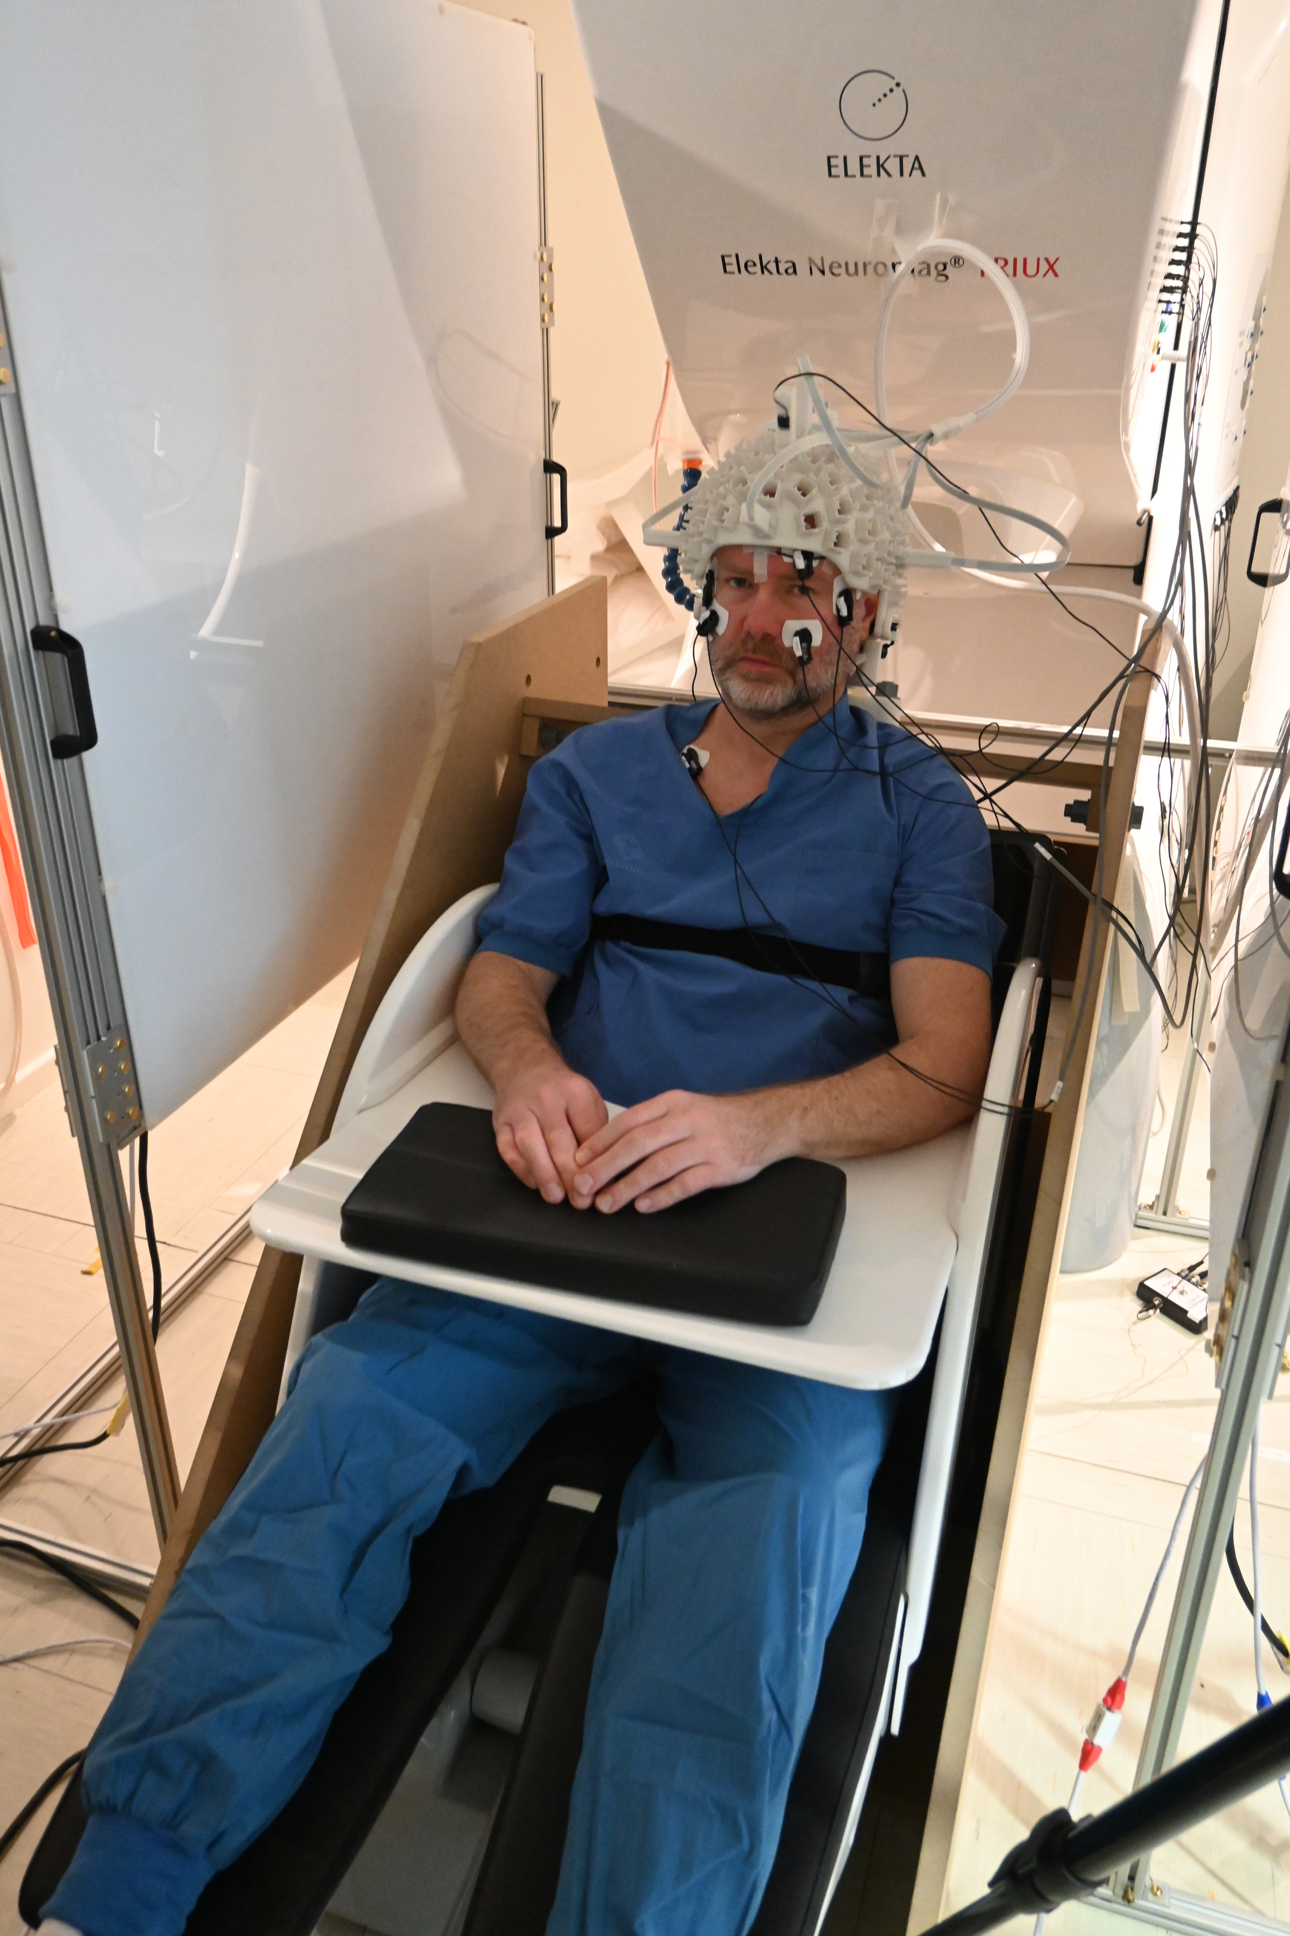
Planar nulling coils
See also Mäkinen et al. (2020) and Zetter et al. (2020), both J Appl Phys

Slide 24
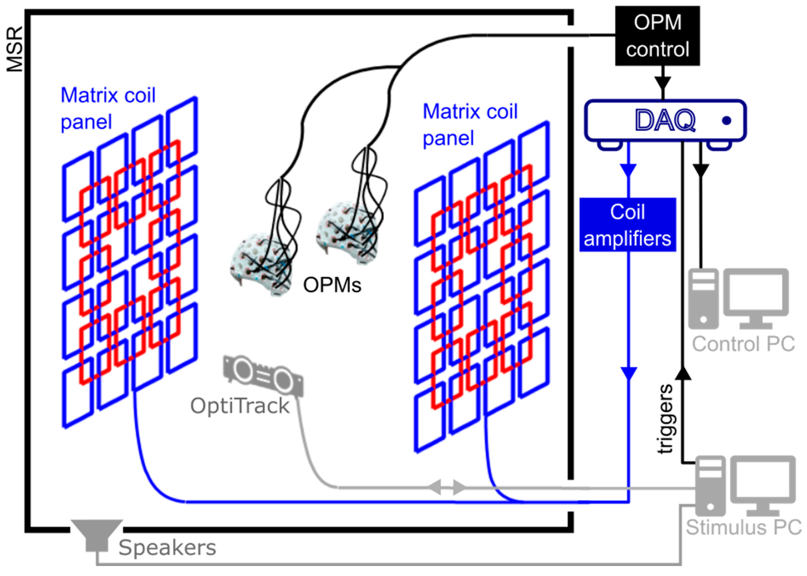
Matrix coils
Holmes et al. (2023) Sensors

Slide 25
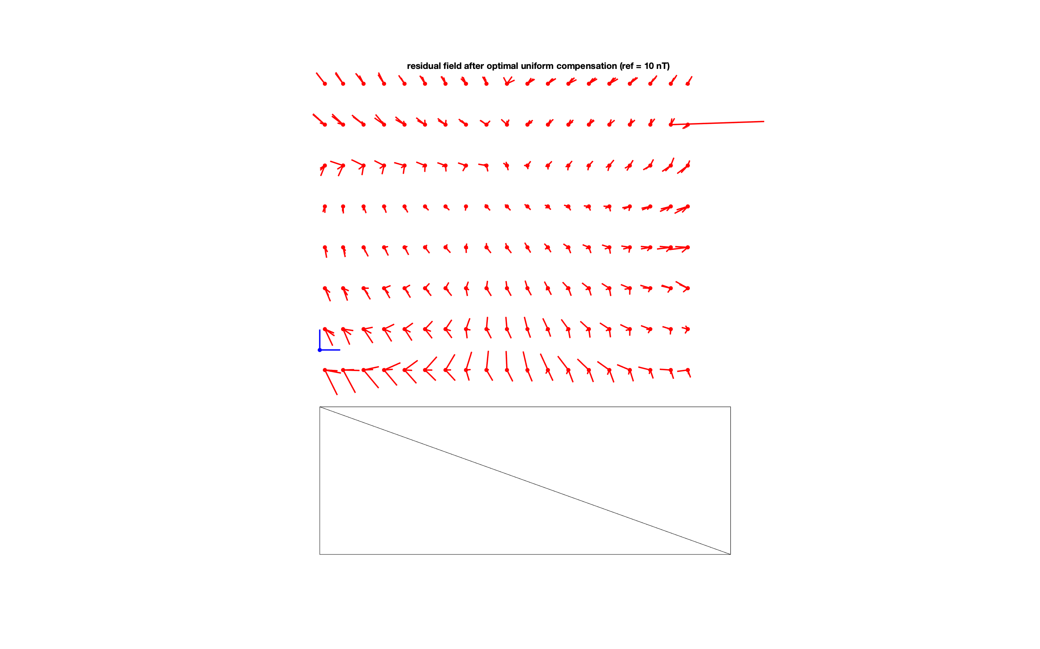
Residual gradient – seen from front after 1st order homogenous field correction (HFC)
chair
Blue arrows are 10 nT
Recordings done at Donders, unpublished. See also Melor et al. 2021

Slide 26
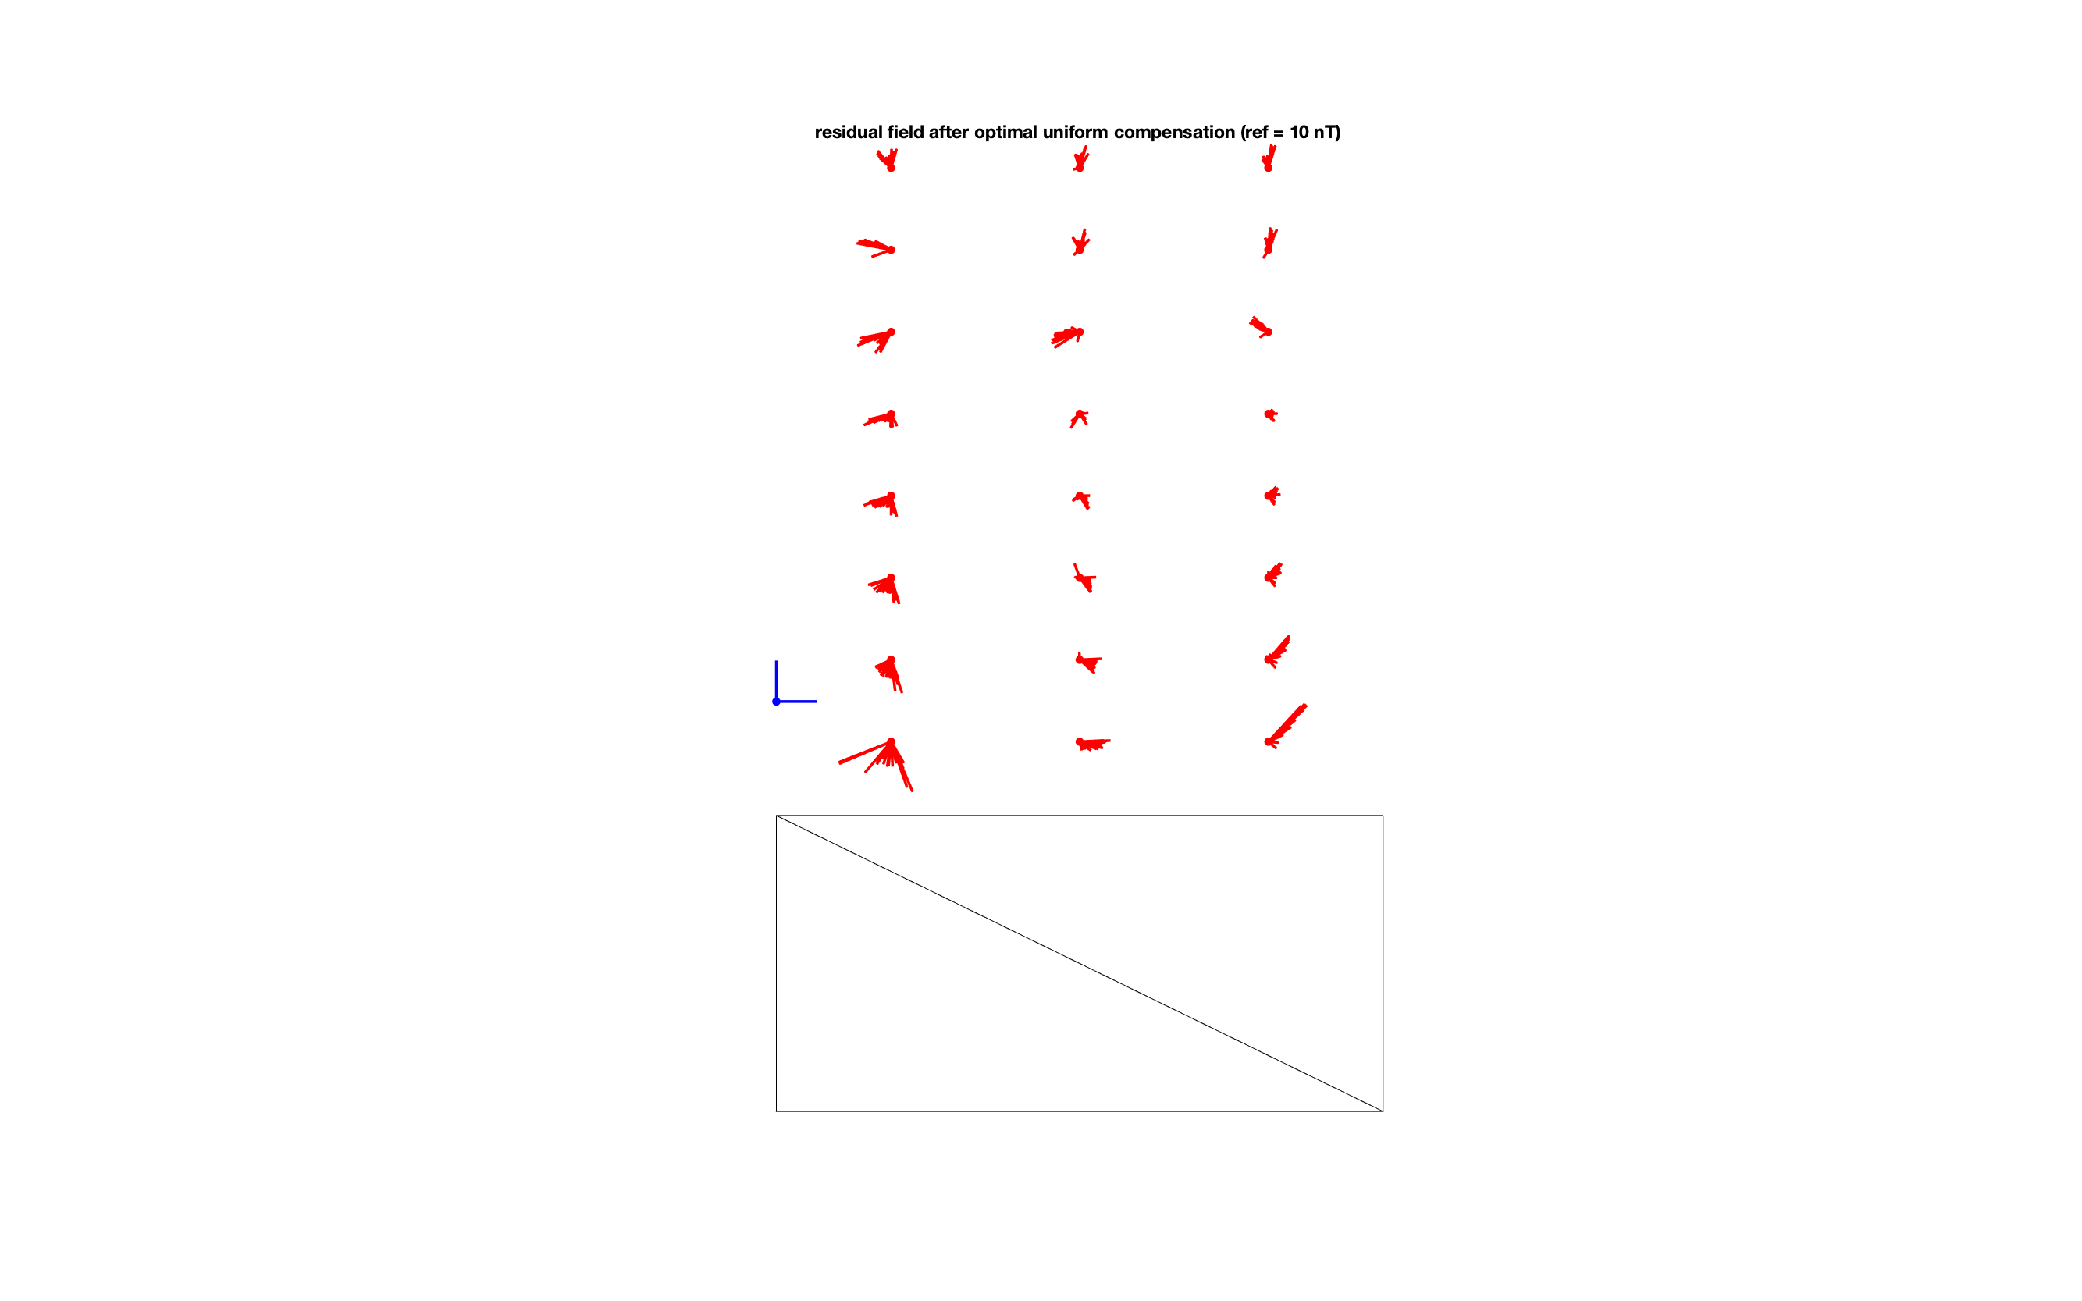
Residual gradient – seen from left after 1st order homogenous field correction (HFC)
chair

Slide 27
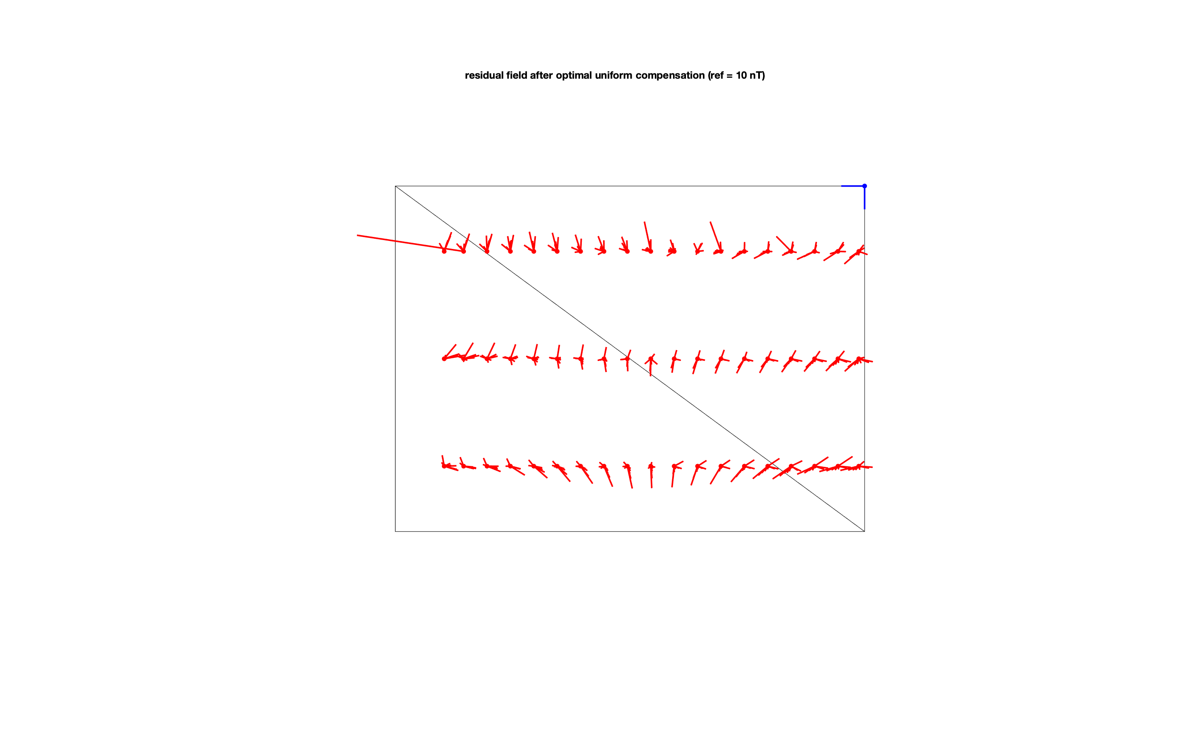
Residual gradient – seen from top after 1st order homogenous field correction (HFC)
front of the subject
right of the subject

Slide 28
How is noise dealt with in the case of MEG? -> Offline data cleaning
The general model of spatiotemporal mixing of many (brain and environmental) sources into the noisy MEG signal is the same as for EEG.
Methods such as PCA, ICA, etc can therefore also be used.
However, compared to EEG, in MEG we often make more explicit (bio)physical models for the sources from the brain and from the environment.
The forward model is better understood for MEG, and is simpler.
Besides SSP, DSSP, SSS, tSSS as for SQUID-MEG, for OPM-MEG we can also use homogenous field correction (HFC) and adaptive multipole modelling (AMM).
Y = G X = G₁X₁ + G₂X₂ + G₃X₃ + ... + G_{n}X_{n}

Slide 29
How is noise dealt with in the case of MEG? -> Beamforming
Rather than, or on top of channel-level cleaning, we can also reduce the impact of noise during source reconstruction.
Beamforming adapts to the noise present in the data. The noise is not modeled explicitly, but is assumed to be represented in the data covariance matrix.
The data, and hence its covariance is a mixture of the source of interest and the noise (= everything else).
The source of interest is explicitly modeled as a dipole and its strength is estimated using a unit-gain spatial passband filter; everything else is suppressed (minimum variance output).
This leads to beamformer methods such as LCMV, DICS, SAM, and others

Slide 30
How to deal with head movements and OPMs?
In SQUID based systems the head is not fixed to the helmet and movement of the head causes blurring of the (averaged) brain activity.
However OPM systems can be designed such that sensors do not move relative to the head, but move along with the head.
The head moves in the residual magnetic field that is fixed in space.
The space (and residual field) moves around the fixed head.
If the head and the OPM helmet/sensors are moving (slightly) independently, the spatiotemporal mixing (and hence cleaning) becomes more complex.

Slide 31
Coregistration of SQUID-MEG
SQUID-based MEG systems have well-established software and standard procedures.
Head position indicator (HPI) coils placed on anatomical landmarks are common in most SQUID-MEG systems (CTF, Neuromag, BTi) and the acquisition software does the coregistration and stores it directly in the raw data file.
Furthermore, Polhemus electromagnetic digitization systems are common and allow to register additional head shape points over the scalp.
Offline coregistration between the individual MRI and MEG sensor positions can be done using the anatomical landmarks (corresponding to the HPI coils) and optionally also between the Polhemus and MRI head shape.

Slide 32
Coregistration of OPM-MEG
OPM systems (and software) are still less complete in their procedures and don’t have standard coregistration procedures.
OPMs allow for flexible placement and hence custom 3D-printed helmets and caps can be used, in that case the acquisition software does not know the positions.
Not only OPM position needs to be determined, also their orientation (in all directions).
OPM coregistration can use the same principles as that for SQUIDs:
HPI coils that are sequentially or simultaneously activated at the start of the session
Polhemus electromagnetic digitization to coregister helmet along with landmarks on the head
3D photogrametry (Zetter et al. 2019)
FieldLine ”smart helmet” that localizes each OPM sensor and thereby the scalp surface
OPMs in fixed/rigid helmet can be localized as an array, whereas individual OPMs in a flexible cap need to be individually coregistered. The Mag4Health piecewise flexible cap is in-between, see also Pfeiffer et al. (2020).

Slide 33
OPM data formats
Most SQUID-MEG systems have their own format.
The FIFF file format (*.fif) was developed in the 2000s for the Neuromag system and is very flexible by using tags, just like TIFF, AVI and DICOM.
It is well supported in Python, MATLAB, and C/C++, both for reading and writing.
Not only for Neuromag data, also allows for representing CTF and BTi data.
Sensor description in ASCII coil_def.dat file
In general the raw data file does not contain all experimental details. For example, what was the task, what do the trigger codes mean, what are the auxiliary channels, how was coregistration done, …

Slide 34
Brain Imaging Data Structure (BIDS)
BIDS is a way to organize your existing raw data
To improve consistent and complete documentation
To facilitate re-use by your future self and others
BIDS is not
A new file format
A search engine
A data sharing platform
BIDS adds the missing bits

Slide 35
BIDS for MRI, PET, EEG, iEEG, and also MEG, …
Directory structure
data/README
/CHANGES
/dataset_description.json
/participants.tsv
/sub-01/anat/…
/sub-01/eeg/…
/sub-01/meg/sub-01_task-auditory_meg.fif
/sub-01/meg/sub-01_task-auditory_meg.json
/sub-01/meg/sub-01_task-auditory_channels.tsv
/sub-01/meg/sub-01_task-auditory_events.tsv
/sub-01/meg/sub-01_headshape.pos
/sub-01/meg/sub-01_coordsystem.json
Metadata
Actual MEG signals
Metadata
Niso et al. 2018, Sci Data

Slide 36
OPM data and BIDS
BIDS is supported by many software packages like FieldTrip, MNE-Python, SPM, BrainStorm, and others.
BIDS is the defacto format for the OpenNeuro (USA) and PublicNeuro (EU) repositories and platforms like BrainLife.
BIDS explicitly allows for the *.fif file format (and some others, but not for just any format).
Metadata description of the coregistration procedure needs to be added.
Details on the OPM sensors needs to be added.
Details of the OPM helmet/cap or sensor placement might need to be added (like for EEG-BIDS).
Work to be done…

Slide 37
OPM-MEG processing
Once the OPM signals, triggers and events are in a supported format, sensor positions and orientations are known, and coregistration is done, processing is business as usual and mostly similar to SQUID-MEG.
ERFs, power spectra and time-frequency analyses all work the same.
Some signal characteristics are different (bandwidth, tangential sensitivity).
Forward models are not different than SQUID-MEG.
Inverse methods are not different than SQUID-MEG and EEG.

Slide 38
OPM-MEG processing is different to SQUID-MEG in some regards
Data cleaning procedures are slightly different (HFC, AMM, …).
Dealing with participant movement in the experiment is a new challenge.
Plotting of spatial topographies is not so trivial for bi- and tri-axial systems.
Standard template layouts for plotting do not apply to custom 3D-printed helmets.

Slide 39
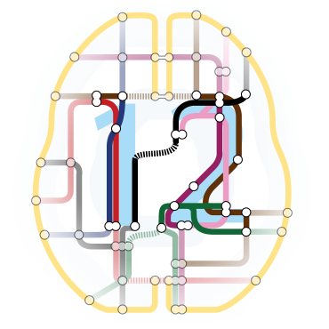
OPM-MEG processing
Existing Open Source MEG analysis toolboxes can read the data, already have OPM support and we are working on adding further OPM-specific functionality, documentation and tutorials.
Existing guidelines (e.g., Gross et al. 2013) and teaching material apply also to OPMs, for example the books “MEG – an introduction to methods” (Hansen et al. 2010) “Magnetoencephalography” (Supek & Aine, 2019)
https://www.fieldtriptoolbox.org
https://mne.tools
https://www.fil.ion.ucl.ac.uk/spm
https://neuroimage.usc.edu/brainstorm

