Slide 1
Introduction to Optically Pumped Magnetometers (OPMs)
Peter D. D. Schwindt

Slide 2
Properties of a Neutral Atoms
Quantized energy levels
n = 3, l = 0,1,2
e⁻
n = 2, l = 0,1
p⁺
Photon
n = 1, l = 0

Slide 3
Properties of a Neutral Atoms
Spin and magnetic moment
  Electron spin
  Nuclear spin
n = 3, l = 0,1,2
n = 2, l = 0,1
e⁻, ½
B
F = 1
n = 1,
l = 0
p⁺
, ½
s = ½
s = -½
m = -1
m = 0
n = 1, l = 0
F = 0
m = 1
Zeeman effect

Slide 4
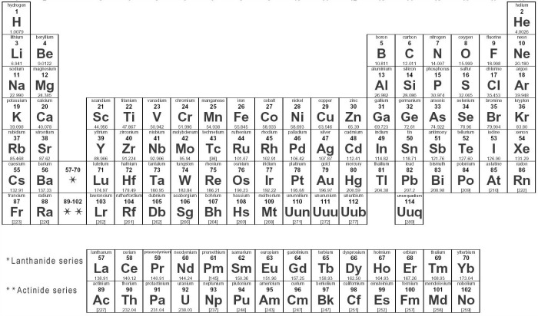
Atoms Used in OPMs

Slide 5
The Rubidium-87 Ground State
Hyperfine
splitting
F = 2
ћω_{L} = 1/4μ_{Β}Β
F = I + S
I = 3/2, S = 1/2
ћω_{HF}
Zeeman splitting
Atom Energy
F = 1
-2 -1 0 +1 +2
m_{F}
Clock—measure hyperfine frequency
Magnetometer—measure Zeeman splitting
Gyromagnetic Ratio = 2π 7 Hz / nT

Slide 6
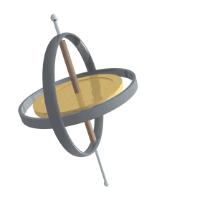
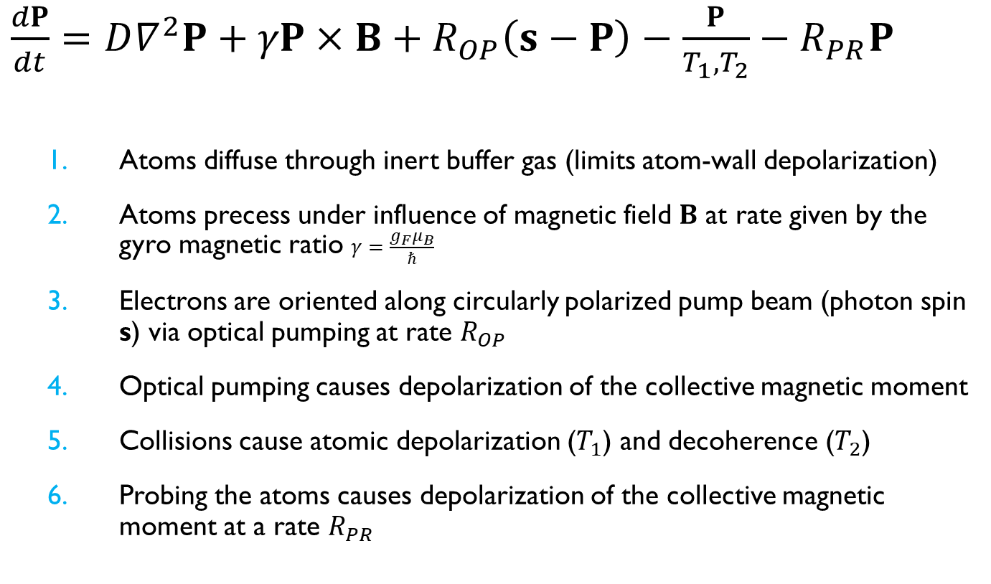
Bloch Equations for an OPM
$\frac{dP}{dt}=D∇^{2}P+γP×B+R_{OP}\left(s−P\right)−\frac{P}{T_{1},T_{2}}−R_{PR}P$
  Atoms diffuse through inert buffer gas (limits atom-wall depolarization)
  Atoms precess under influence of magnetic field $B$ at rate given by the gyro magnetic ratio $γ=\frac{g_{F}μ_{B}}{ℏ}$
  Electrons are oriented along circularly polarized pump beam (photon spin s) via optical pumping at rate $R_{OP}$
  Optical pumping causes depolarization of the collective magnetic moment
  Collisions cause atomic depolarization ($T_{1}$) and decoherence ($T_{2}$)
  Probing the atoms causes depolarization of the collective magnetic moment at a rate $R_{PR}$
By Lucas Vieira - Own work, Public Domain, https://commons.wikimedia.org/w/index.php?curid=1528090

Slide 7
Zero-Field/SERF Magnetometer (Vector)
Alkali Vapor Cell
Optical pumping
Circular
polarization
Pump beam
Randomly oriented atomic spins
Spins align with the pump beam
Apply Small Magnetic Field
Detect with probe beam
Probe beam
Output polarization
B
B
Spins precess due to magnetic field
Oriented spins rotate the polarization (Faraday rotation)
Input polarization
Out of
plane

Slide 8
Signals to Detect
Spin Polarization Bloch Equation
x
z
Transverse Pump
y
Probe beam
B
Bx = Bz = 0 Steady State Solution
Detect the Pump
Atomic Polarization, P_{z}
Pump Transmission
Atomic Polarization, P_{x}
or Angle of Light Polarization
B₀+B₁sin(ωt)

Slide 9

Zero-Field SERF Magnetometer

Slide 10
Two-color pump/probe scheme
Two optical resonances in Rubidium (fine structure)
  Use D1 for optical pumping and D2 for probing
  Based on: V. Shah and M. V. Romalis, PRA 80, 013416 (2009)
⁸⁷Rb Fine Structure
Field modulation/phase sensitive detection
required to extract dispersive lineshape
5²P_{3/2}
Multiorder
Waveplate
Dichroic optical components
Detect on D2
Optically pump on D1
5²P_{1/2}
To analyzer
To analyzer
D1
795 nm
Input polarization
Output polarization
D2
780 nm
Linearly polarized 780 nm probe beam
Oriented spins rotate the polarization
Circularly polarized D1 pump beam
B₀+B₁sin(ωt)
D1 λ/4
D2 λ/2
780 nm
bandpass filter
D1 λ/4
D2 λ/2
780 nm
bandpass filter
5²S_{1/2}

Slide 11
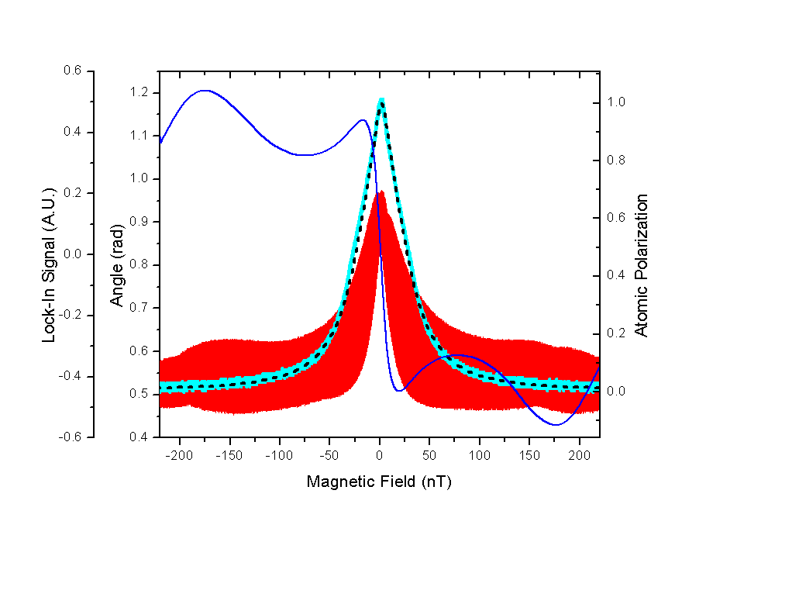
Magnetometer Signals
Blue trace: Magnetometer (lock-in) signal

Slide 12
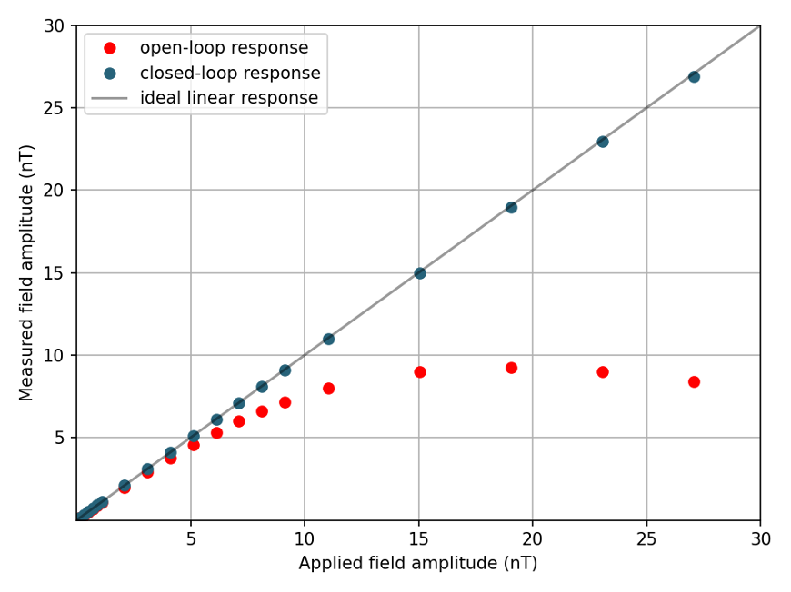
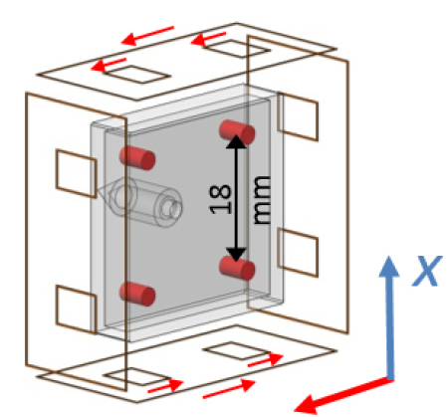
Linearity of OPMs
B_{x}
B_{y}
From Svenja Knappe

Slide 13
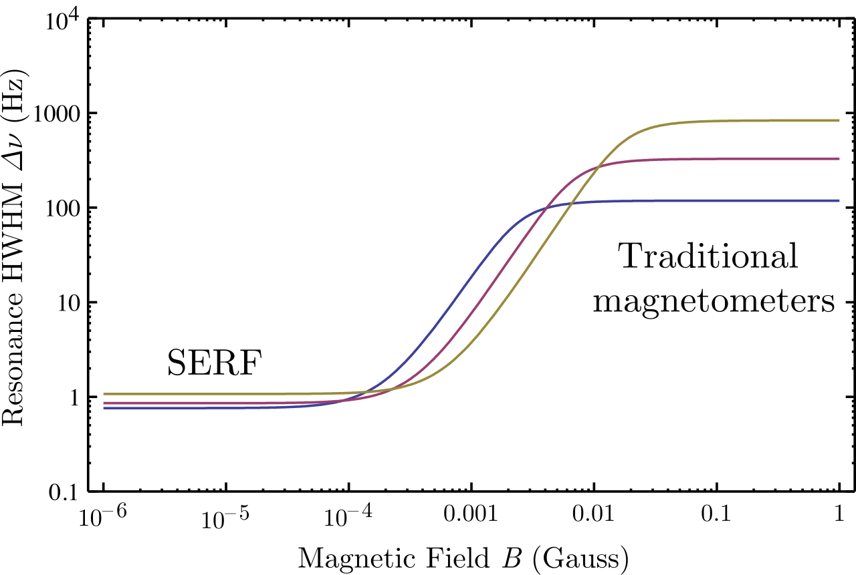

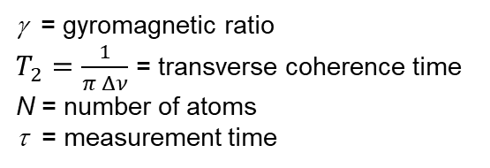
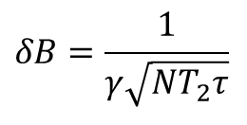
What is SERF?
Spin Exchange Relaxation Free
T₂ often limited by spin exchange collisions.
Near zero field and at high density, spin exchange rate >> spin precession frequency
  More F = 2 states, so on average atoms precess in F = 2 direction
  Precession rate is slowed down by nuclear spin and incomplete optical pumping
Record sensitivity: 160 aT / Hz^{1/2}
  Atom shot noise: ~0.1 fT / Hz^{1/2}
SERF in a ~6 mm³ scale cell: 5 fT / Hz^{1/2}
⁸⁷Rb Ground States
$$δB=\frac{1}{γ\sqrt{NT_{2}τ}}$$
F = 2
F = 1
γ = gyromagnetic ratio
$T_{2}=\frac{1}{π Δν}$ = transverse coherence time
N = number of atoms
τ = measurement time
m_{F}
-2 -1 0 +1 +2
Rubidium relaxation cross sections
σ_{SE} = 2 x 10⁻¹⁴ cm²
σ_{SD} = 9 x 10⁻¹⁸ cm²
Twarge, CC BY-SA 4.0, https://creativecommons.org/licenses/by-sa/4.0, via Wikimedia Commons
H. D. Dang, A. C. Maloof, M. V. Romalis, Applied Physics Letters 97, 151110 (2010)
W. C. Griffith, S. Knappe, and J. Kitching, Optics Express, 18, 27167-27172 (2010).

Slide 14
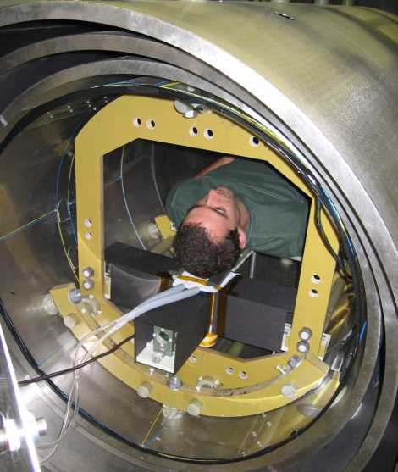
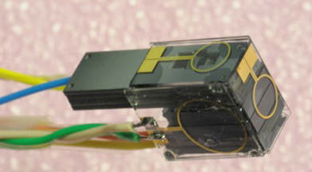
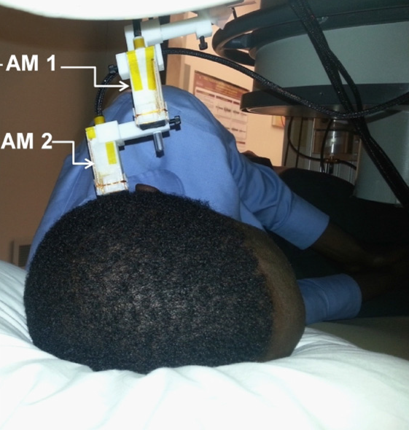
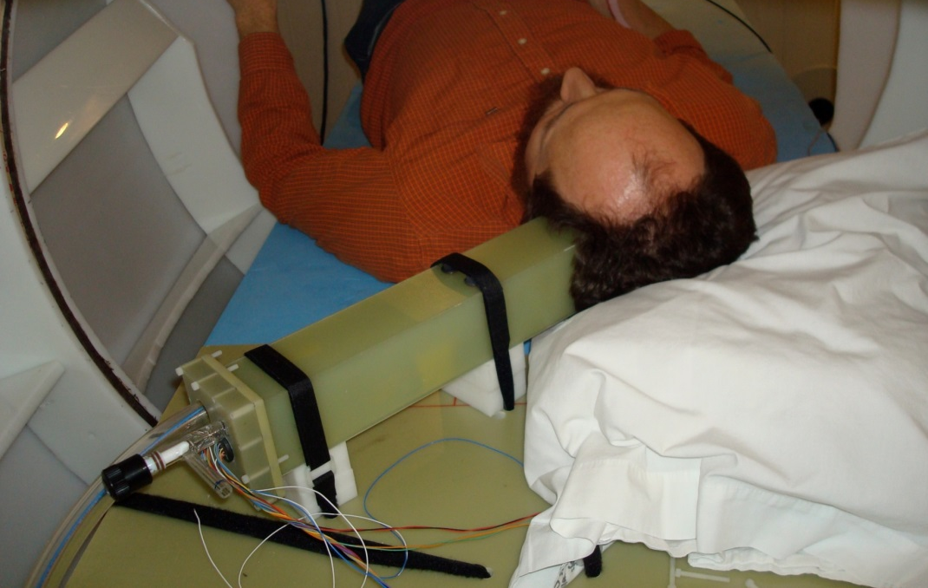
OPMs for MEG: Early work was all SERF
Princeton/Twinleaf OPM MEG System
2006
NIST Miniature Magnetometer 2012
-now FieldLine Inc.
Sandia Atomic
Magnetometer
2010
2013
QuSpin Inc. Magnetometer

Slide 15
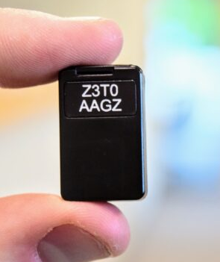


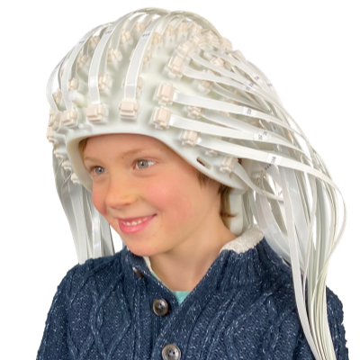

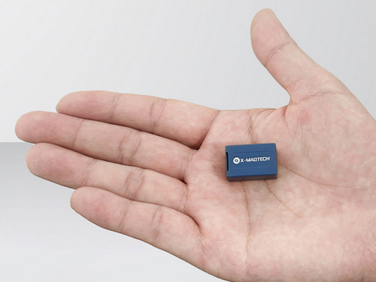

Emerging Companies Using Zero-Field/SERF OPM
*
*Assuming this is a zero-field/SERF OPM

Slide 16
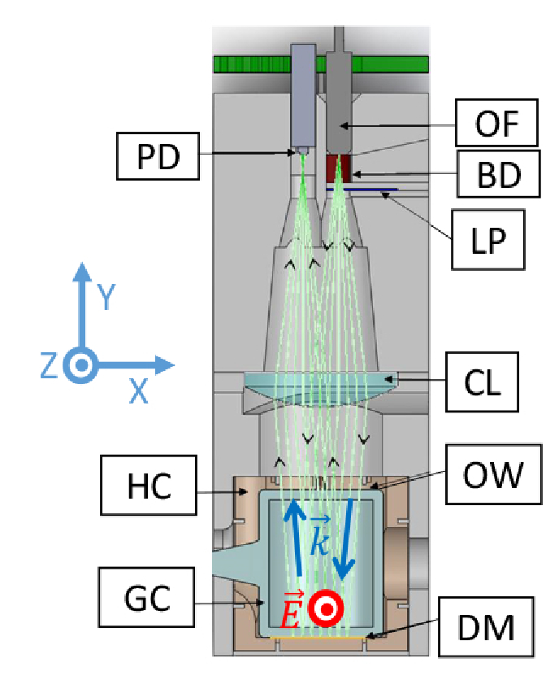
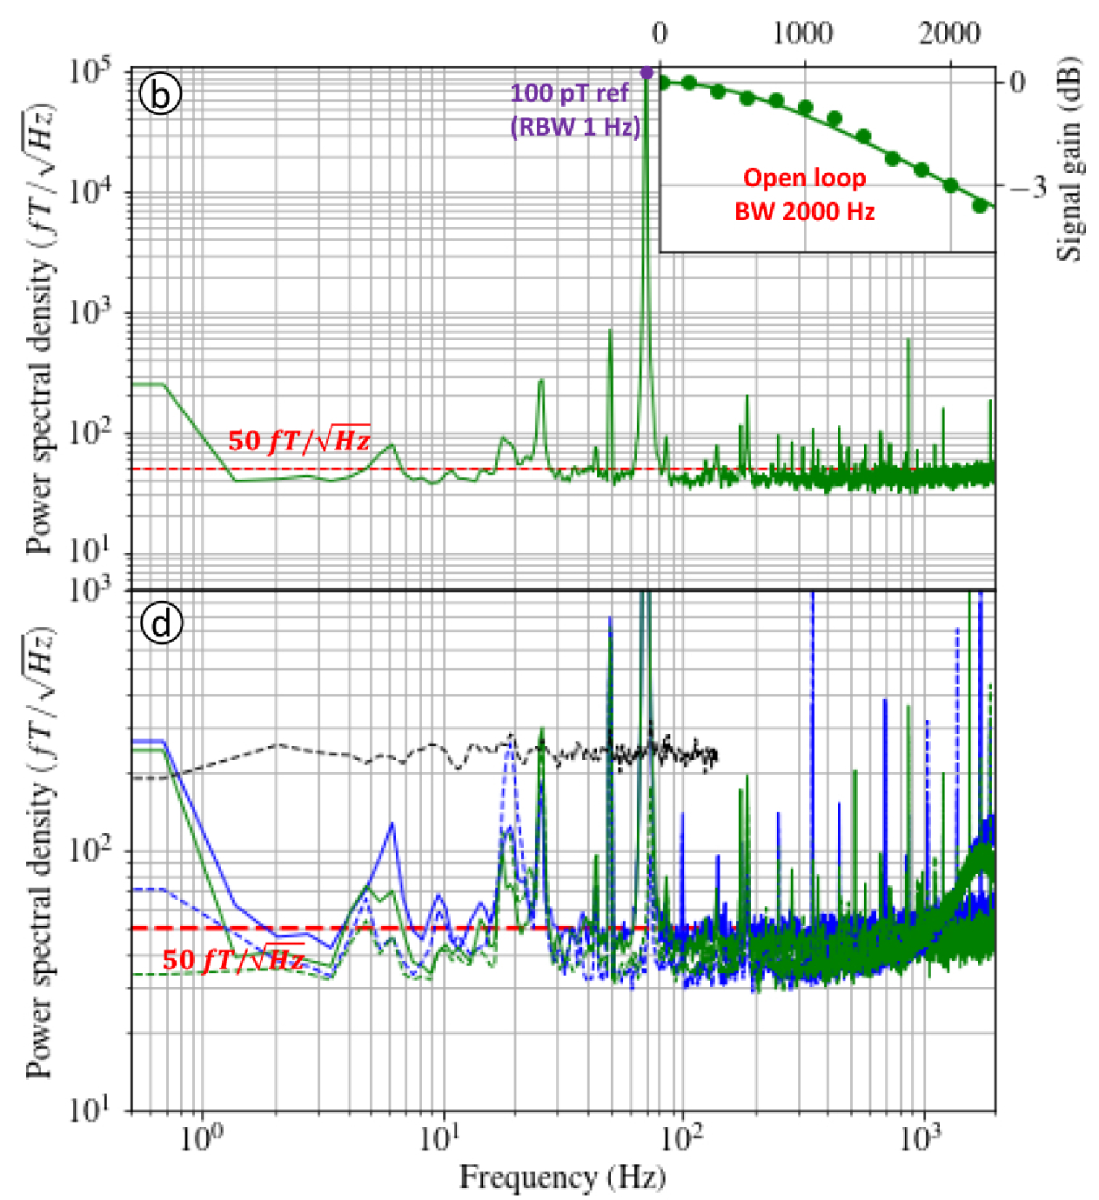
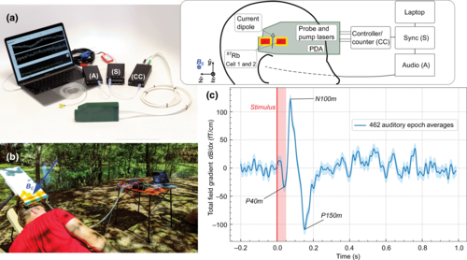




Other types of OPM
Helium-4 OPM
Unshielded MEG using scalar OPM
Sensitivity: 50 fT/rt-Hz
Closed-loop, triaxial operation
No cell heating: 10 mW RF discharge
Gradiometric Sensitivity: 15 fT/cm/rt-Hz
Measure field component parallel to ambient field
No crosstalk / magnetically silent
William Fourcault, et al., Opt. Express 29, 14467-14475 (2021)
Limes, M.E., et al., Phys. Rev. Appl. 14, 011002 (2020)

Slide 17
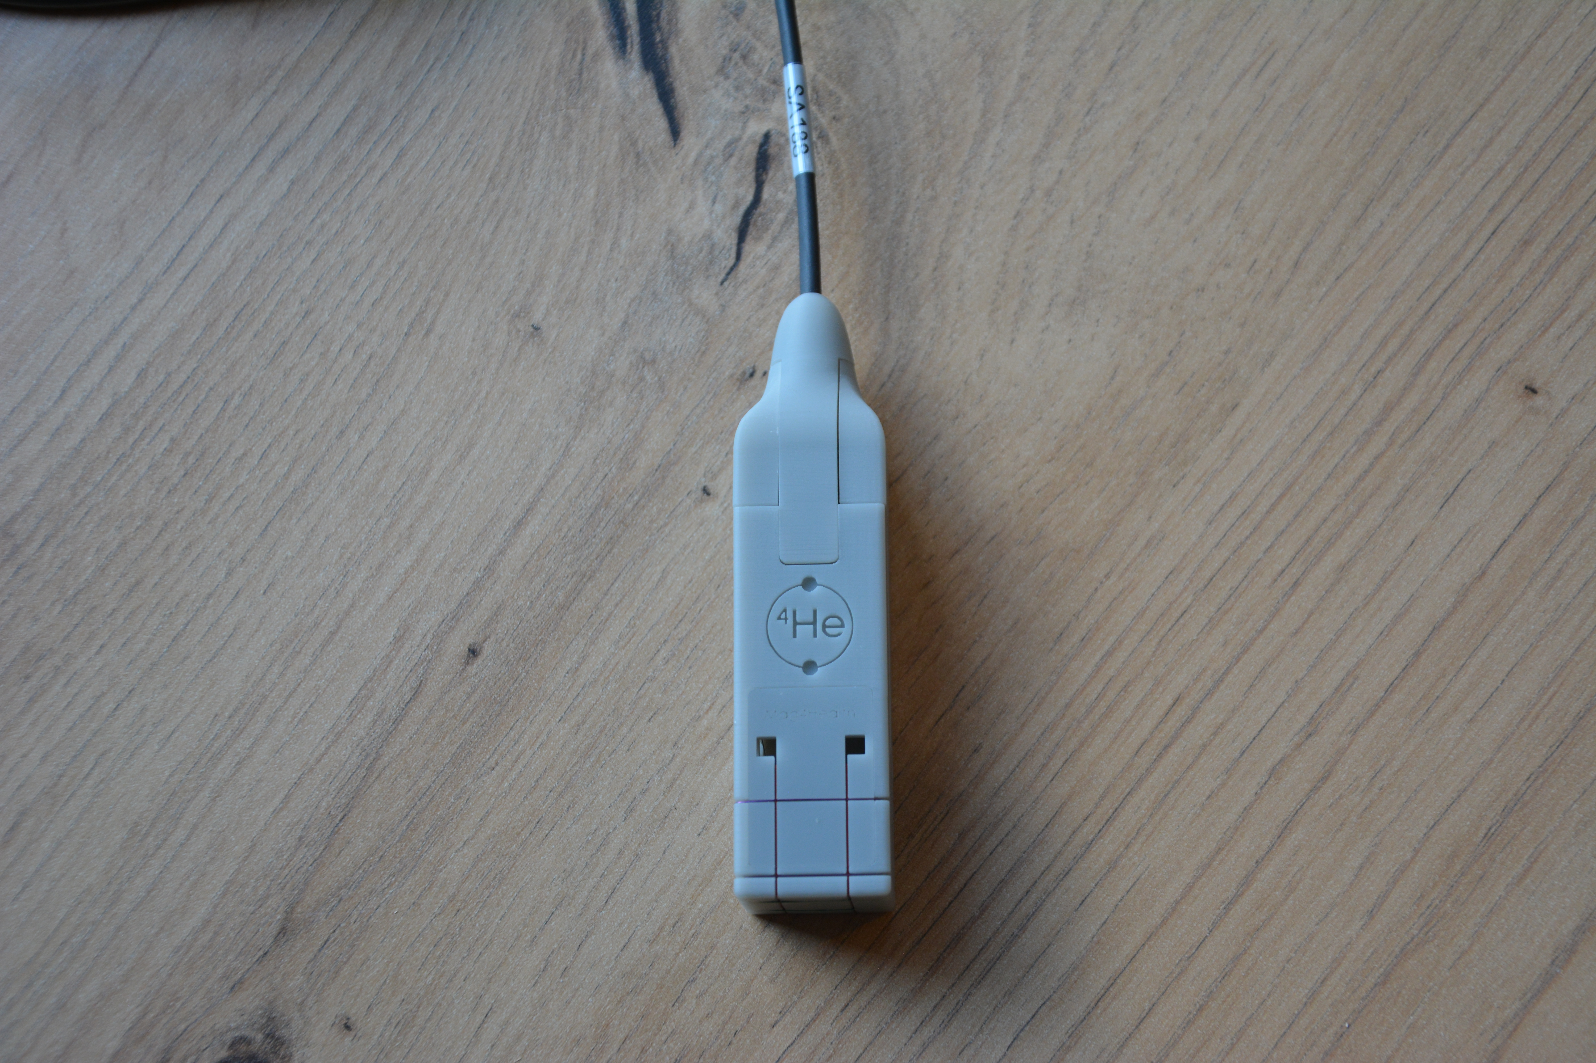







Helium-4 OPM - principle
Linear polarization
$$x$$
pump/probe
laser beam
$$\vec{E}$$
$$\vec{e_{x}}b_{x}cos\left(Ωt\right)$$
photo-detector
6 cm
$$z$$
demodulation
$$\vec{e_{z}}b_{z}cos\left(ωt\right)$$
$$\vec{B_{y}}$$
$$\vec{B_{x}}$$
$$∝B_{x}$$
$$∝B_{y}$$
$$∝B_{z}$$
$$∝B_{y}$$
2x2 cm
$$\vec{B_{z}}$$
-1
$$Ω$$
$$ω$$
$$ω−Ω$$
$$ω+Ω$$
-2
Signal (Arb. Units)
Parametric resonances
along each direction
with 2 rf fields
and 1 laser beam
-3
Magnetic ALIGNED
state
-100
-50
0
50
100
Magnetic field amplitude (nT)
F. Beato et al. Phys. Rev. A 98, 053431 (2018)

Slide 18
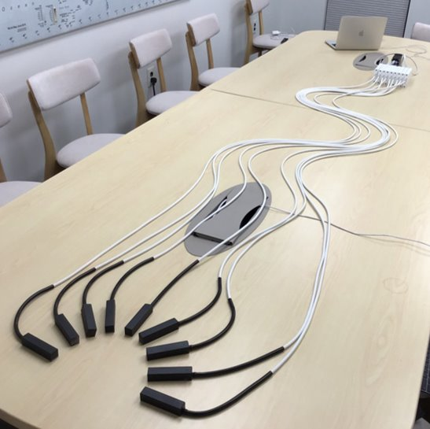
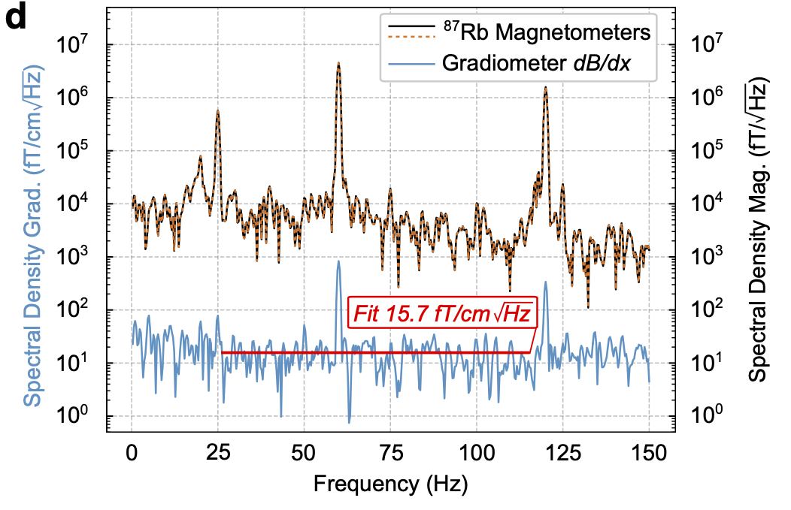
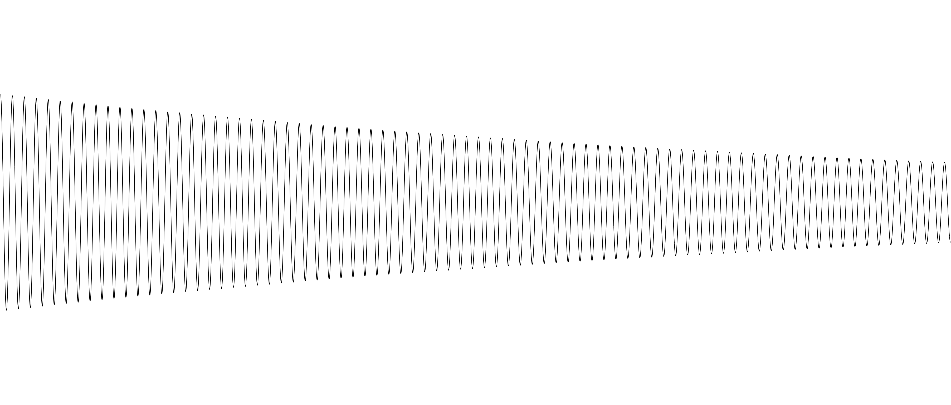
Pulsed Pump Magnetometer
High performance Optical Magnetic Gradiometers
Zero field
SERF OPM
Operate at nonzero background field
Probe
~1 ms
θ∝B
Pump
<1 µs
f = ɣB
Measure
spin angle
⁸⁷Rb Spin
Probe
Measure
spin frequency
⁸⁷Rb Spin
By
⁸⁷Rb Spin
By
σ+ Pump
σ+ Light
Extraordinary sensitivity without magnetic shielding
Free-induction decay frequency
PUMP PULSE
PUMP PULSE

Slide 19
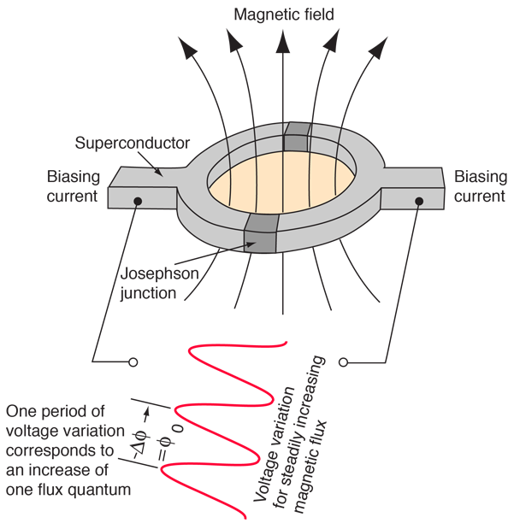
SQUID vs OPM
SERF OPM
SQUID
B_{x}
B_{y}
http://hyperphysics.phy-astr.gsu.edu/hbase/Solids/Squid.html
Integrates over volume of laser beam
Sensitive axis determined by field modulation (Some SERF designs use laser beam geometry to define sensitivity axis.)
Integrates over the area of pickup loop
Sensitive axis determined by loop geometry

Slide 20
SQUID vs OPM
 | Sensitivity | Bandwidth | Sensitive axis | Dynamic range (Max field)
Zero field, SERF OPM | 5-20 fT/rt-Hz | 80-150 Hz (open loop) 350 Hz (closed loop)** | 1, 2, or 3 axis (3rd axis from 2nd OPM) | ±2 nT (80 nT) open loop* ±150 nT (150 nT) closed loop**
He OPM | 50 fT/rt-Hz | 2 kHz (open loop) 1.35 kHz (closed loop) | 3 axis (3rd axis 6x worse sensitivity) | ±300 nT (unknown)
Scalar OPM gradio-meter—Unshielded | 15 fT/cm/ rt-Hz | 300 Samples/s (adjustable) | Parallel to am-bient bias field | Unknown (Earth’s field)
SQUID | 2-3 fT/rt-Hz | 1–5 kS/s (adjustable) | Normal to pickup loop | ±20 nT (Unshielded operation possible)
*Quspin Neuro-1: Neuro-1 flyer
**Fieldline: Alem O, et al.,Front. Neurosci. 17, 1190310 (2023)
Unknown = Unknown to this author

Slide 21
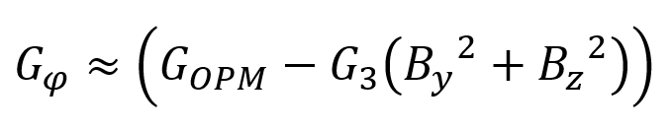





SERF OPMs: Formulating Gain/Sense-Angle Error
$$B_{x}=\hat{B_{xs}}\left(t\right)+B_{m}\sin{(ω_{m}t)}$$
$$P_{z}≈\frac{R_{op}}{R_{op}+R_{rel}}J_{0}\left(\frac{γB_{m}}{{qω}_{m}}\right)J_{1}\left(\frac{γB_{m}}{{qω}_{m}}\right)\sin\left(ω_{m}t\right)\left[\frac{\frac{γ\hat{B_{xs}}\left(t\right)}{\left(R_{op}+R_{rel}\right)}}{1+{\left(\frac{γ\hat{B_{xs}}\left(t\right)}{\left(R_{op}+R_{rel}\right)}\right)}^{2}}−{J_{0}}^{2}\left(\frac{γB_{m}}{{qω}_{m}}\right)\left\{\frac{\frac{γ^{2}B_{y}B_{z}}{{\left(R_{op}+R_{rel}\right)}^{2}}}{1+{\left(\frac{γ\hat{B_{xs}}\left(t\right)}{\left(R_{op}+R_{rel}\right)}\right)}^{2}}+\frac{\frac{γ\hat{B_{xs}}\left(t\right)}{\left(R_{op}+R_{rel}\right)}}{{\left(1+{\left(\frac{γ\hat{B_{xs}}\left(t\right)}{\left(R_{op}+R_{rel}\right)}\right)}^{2}\right)}^{2}}\left.\left({\left(\frac{γB_{y}}{\left(R_{op}+R_{rel}\right)}\right)}^{2}+{\left(\frac{γB_{z}}{\left(R_{op}+R_{rel}\right)}\right)}^{2}\right)\right.\right\}\right]$$
$$G_{OPM}$$
$$G_{2}$$
$$G_{3}$$
Cross Axis Projection Error (CAPE) Effects
$φ_{i}≈arctan\left(\frac{−G_{2}B_{i}}{G_{OPM}}\right), i=y or z→$Rotation of the sensitive axis
$→$Reduction of gain
Phase errors
  Amir Borna, Joonas Iivanainen, Tony R. Carter, Jim McKay, Samu Taulu, Julia Stephen, Peter D.D. Schwindt, “Cross-Axis projection error in optically pumped magnetometers and its implication for magnetoencephalography systems,” NeuroImage, 247, 118818 (2022).

Slide 22
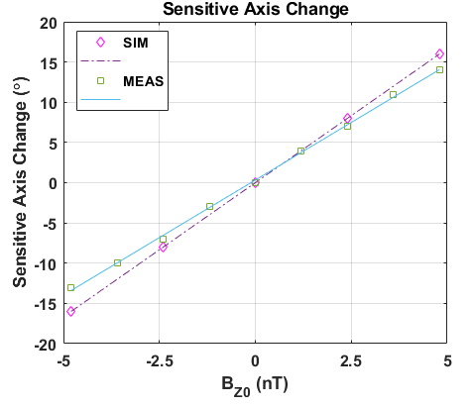
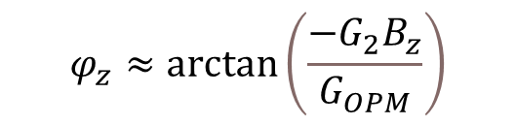
Sensitive Axis Rotation: Simulation vs. Measurement
$$φ_{z}≈arctan\left(\frac{−G_{2}B_{z}}{G_{OPM}}\right)$$
CAPE rotates the sensitive axis by 2.86 °/nT (measured) and 3.33 °/nT (simulated).
The slight difference between the two is attributed to different relaxation rates.

Slide 23
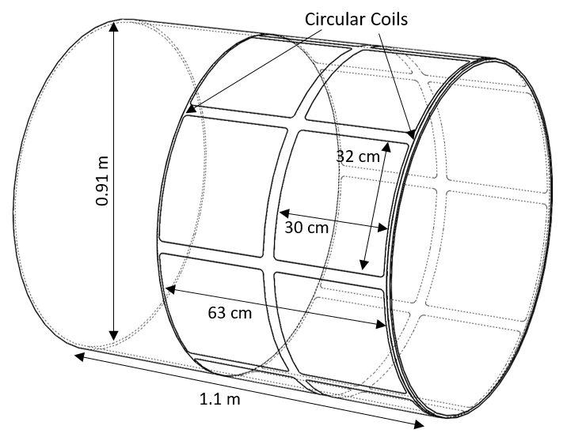
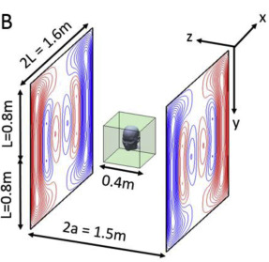
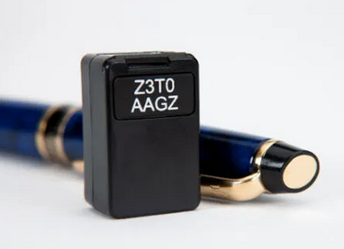
Mitigation of CAPE
Sandia Person-Sized Shield Coils
Zero the fields (easier)
  Zero the field at each sensor (< nT)
  Zero the field in the shield
Closed-loop, 3-axis OPM (harder)
  Upside: It’s a 3-axis measurement!
    Can we maintain good sensitivity?
  Upside: Fixed gain. Sensors are always calibrated.
  Downside: cross-talk between sensors.
Nottingham Biplanar Coils
NeuroImage, 181, 760-774 (2018)
QuSpin Gen 3 QZFM
Triax Variant: <23 fT/√Hz in 3-100 Hz band (typical 15 fT/√Hz all axis simultaneous)
Uses 2 perpendicular beams
NeuroImage, 236, 118025 (2021)
NeuroImage, 252, 119027 (2022)

Slide 24
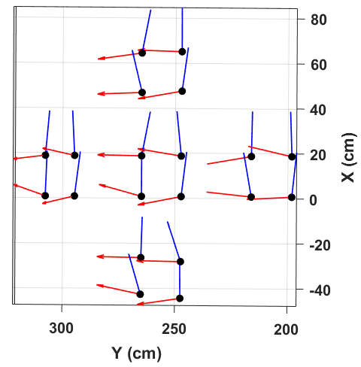
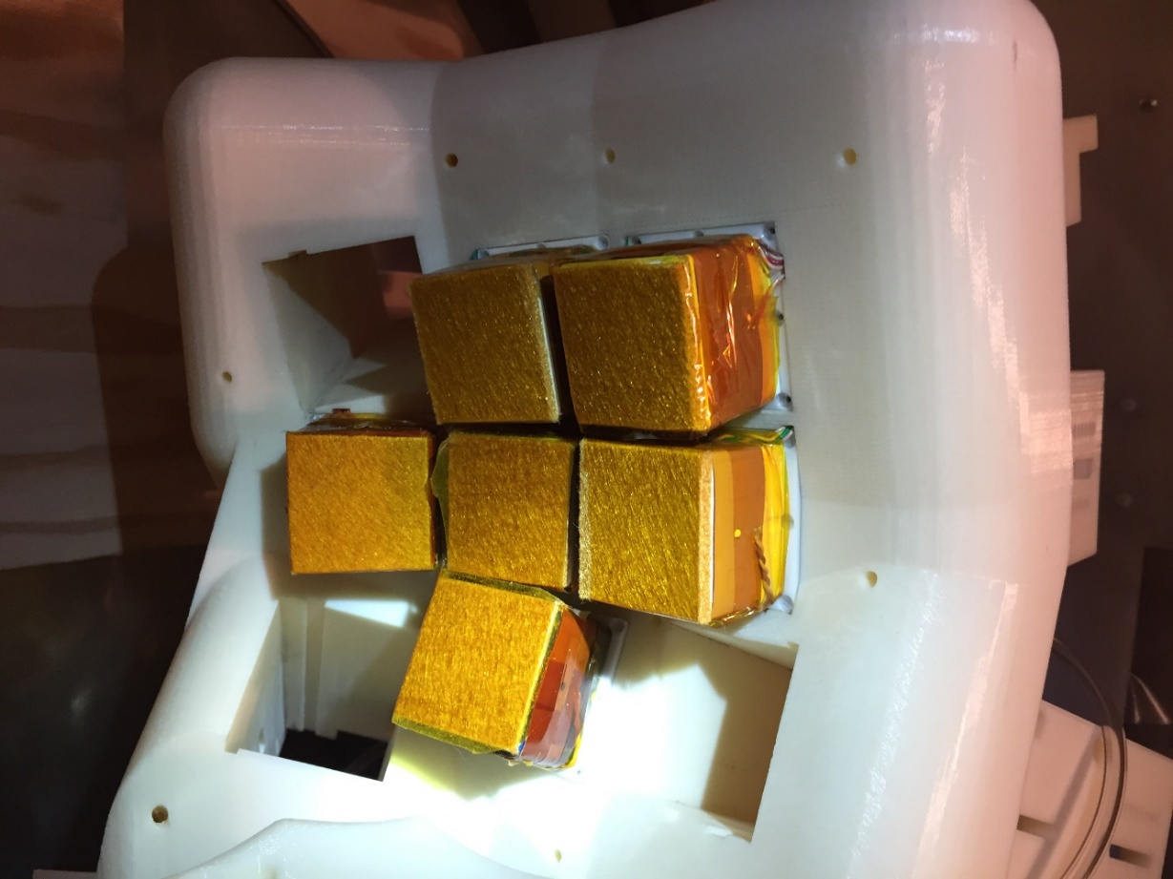
Interference and crosstalk
Interference
  Leakage of the modulation field from one sensor to another
  Can easily be ameliorated through sensor calibration
Crosstalk in closed loop system
  Cancelling field at one sensor is sensed by another sensor
  Mitigation: Design feedback coils that minimize cross talk.
  Mitigation: A cross-talk matrix may need to be measured for each sensor configuration.

Slide 25
Reporting results
Sensitivity results should be normalized by the bandwidth.

Slide 26
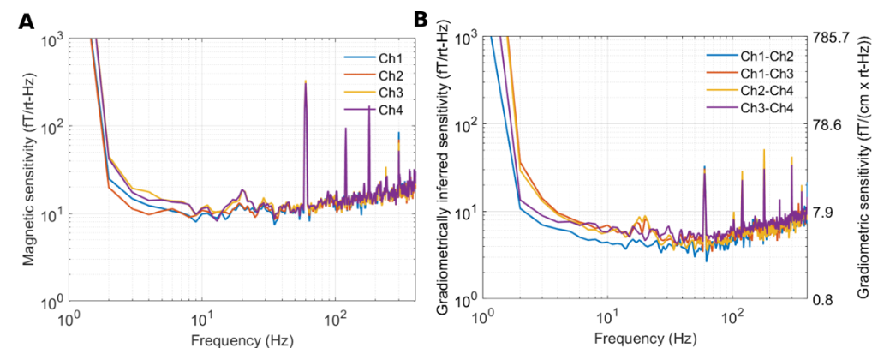
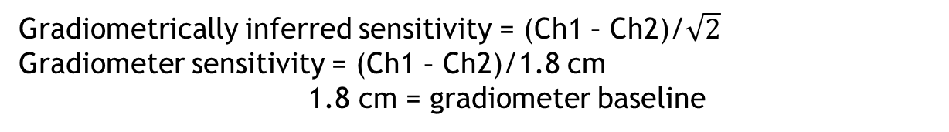
Reporting results
Table Vibration
Gradiometrically inferred sensitivity = (Ch1 – Ch2)/$\sqrt{2}$
Gradiometer sensitivity = (Ch1 – Ch2)/1.8 cm
1.8 cm = gradiometer baseline

Slide 27
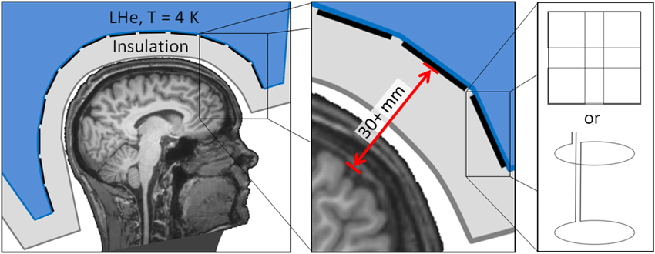
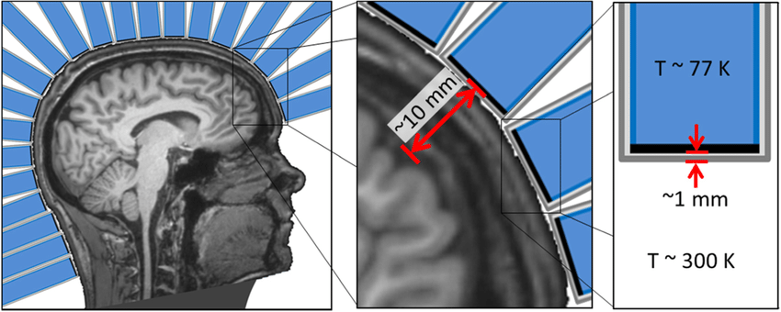

Conclusions
OPMs are fundamentally different than SQUID sensors
  OPMs integrate field over a volume, not an area
  Bandwidth reduced compared to SQUID, at least for SERF OPMs
  Sensitivity of today’s OPM are reduced compared to SQUIDs
    Mitigated by being closer to the head
    Prospects for better OPM sensitivity: Best OPM 0.16 fT/rt-Hz
  OPM respond to all components of the field
    “Vectorization” methods needed to read out specific field components
    Three-axis detection possible
    Systematic errors arise from offset field
SERF and He OPM need a low-field environment
Scalar gradiometer operates in Earth’s field
[1]
[1]-modified
T ~ 180 C
~ 15 mm
~ 10 mm

Slide 28
Back up slides

Slide 29
Optical Pumping
²P_{1/2}
Lifetime ~ 27 ns
²P_{1/2}
σ₊
σ₊
²S_{1/2}
²S_{1/2}
m_{S} = -½
m_{S} = ½
m_{S} = -½
m_{S} = ½

Slide 30
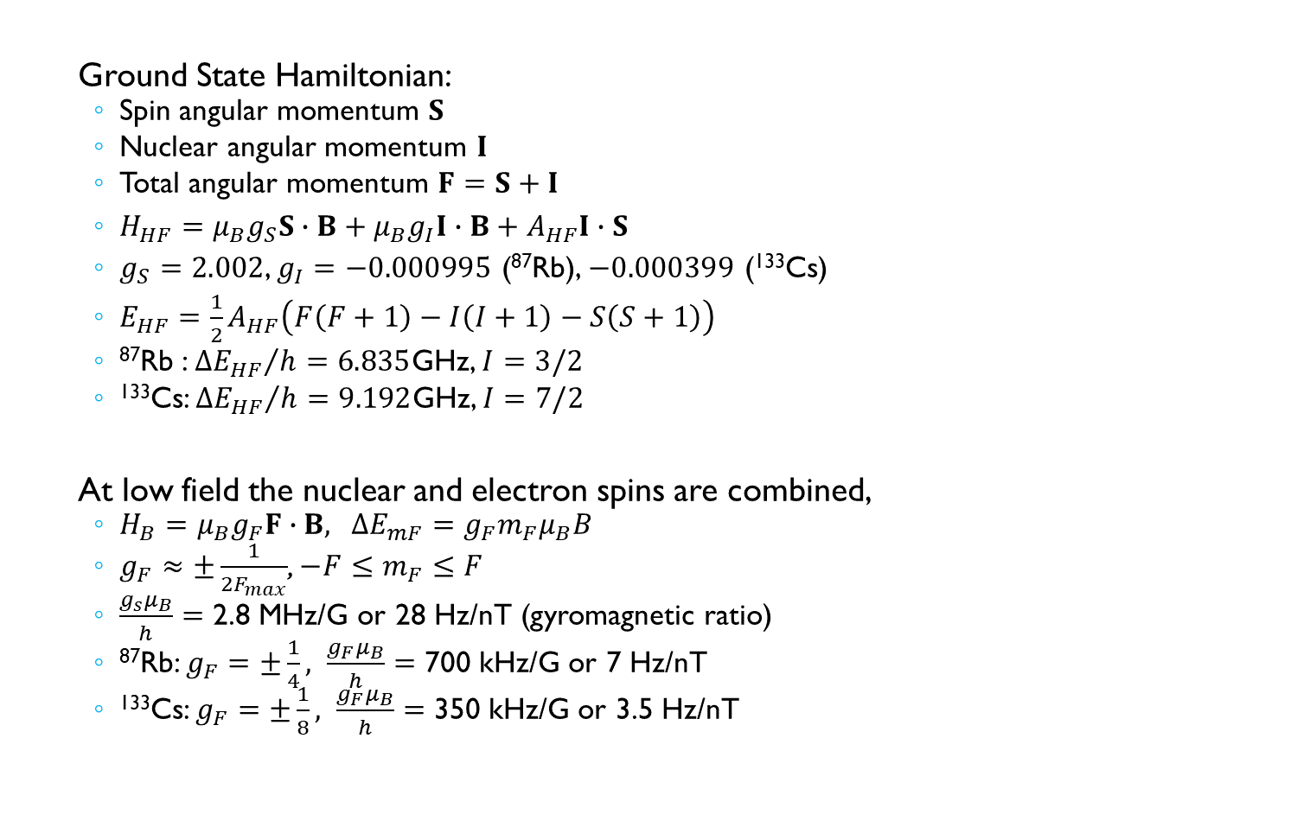
Hyperfine Ground State
Ground State Hamiltonian:
  Spin angular momentum $S$
  Nuclear angular momentum $I$
  Total angular momentum $F=S+I$
  $H_{HF}=μ_{B}g_{S}S∙B+μ_{B}g_{I}I∙B+A_{HF}I∙S$
  $g_{S}=2.002$, $g_{I}=−0.000995$ (⁸⁷Rb), $−0.000399$ (¹³³Cs)
  $E_{HF}={\frac{1}{2}A}_{HF}\left(F\left(F+1\right)−I\left(I+1\right)−S\left(S+1\right)\right)$
  ⁸⁷Rb : ${{∆E}_{HF}}/h=6.835$GHz, $I=3/2$
  ¹³³Cs: ${{∆E}_{HF}}/h=9.192$GHz, $I=7/2$
At low field the nuclear and electron spins are combined,
  $H_{B}=μ_{B}g_{F}F∙B$, $∆E_{mF}=g_{F}m_{F}μ_{B}B$
  $g_{F}≈±\frac{1}{{2F}_{max}}$, $−F≤m_{F}≤F$
  $\frac{g_{s}μ_{B}}{h}=$ 2.8 MHz/G or 28 Hz/nT (gyromagnetic ratio)
  ⁸⁷Rb: $g_{F}=±\frac{1}{4}, \frac{g_{F}μ_{B}}{h}=$ 700 kHz/G or 7 Hz/nT
  ¹³³Cs: $g_{F}=±\frac{1}{8}, \frac{g_{F}μ_{B}}{h}=$ 350 kHz/G or 3.5 Hz/nT

Slide 31
Sensitivity Limits
Magnetic
Sensitivity
Atom shot noise limit
Decoherence limits noise to 1/N^{1/2} scaling
Sensitivity improved by increasing T₂ or N
Most AMs do not operate at this limit.
Photon shot noise limit
Most AMs operate at or near the photon shot noise limit
Probe intensity contributes to T₂ so N_{ph} cannot be made arbitrarily high.
γ = gyromagnetic ratio
T₂ = transverse coherence time
N = number of atoms
τ = measurement time

Slide 32
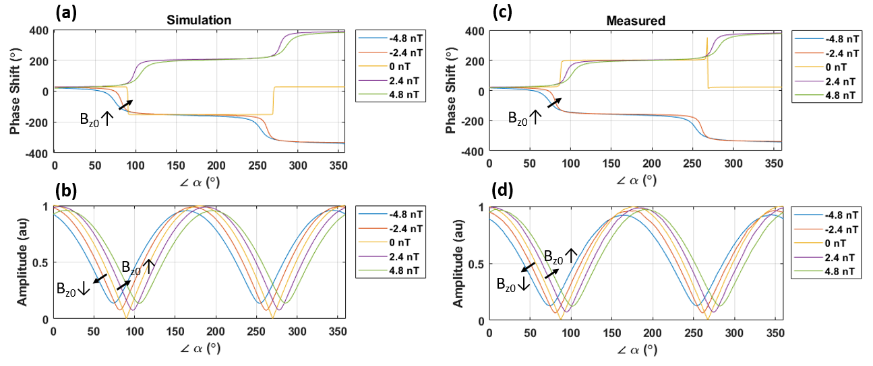
Simulation vs. Measurement, CAPE
OPM’s cross-axis projection error for a 25 Hz, sinusoidal signal with an amplitude of 0.33 nT.

Slide 33
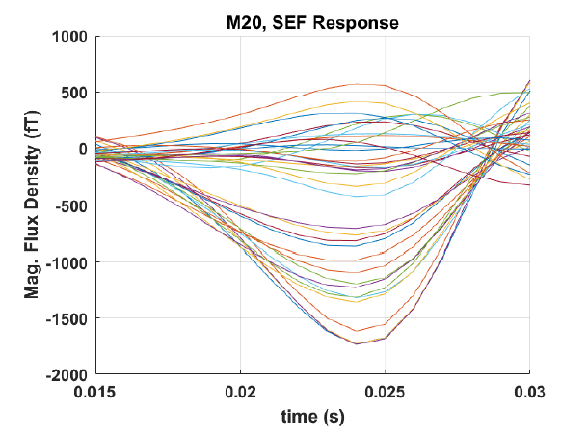
Impact of CAPE on MEG Signals: M20 Median Nerve Response
Wide bandwidth of SEF response at 20 ms (M20) reveals possible effects of CAPE.

Slide 34
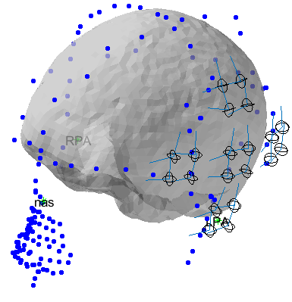
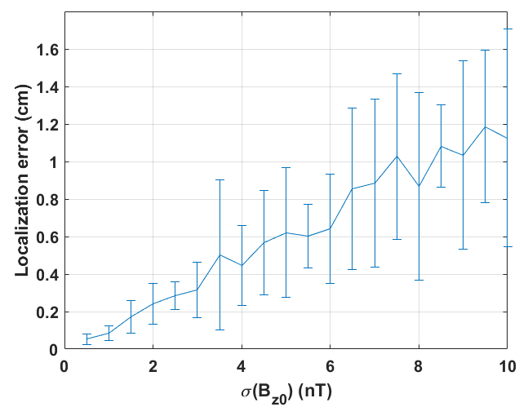
Impact of CAPE on OPM-MEG Systems’ Localization Capability
Poster Number: IM-29
Amir Borna
The mean and standard deviation (bars) for source localization error; the x-axis is the standard deviation of the remnant static magnetic field on the laser propagation axis selected from a normal gaussian distribution.

Slide 35
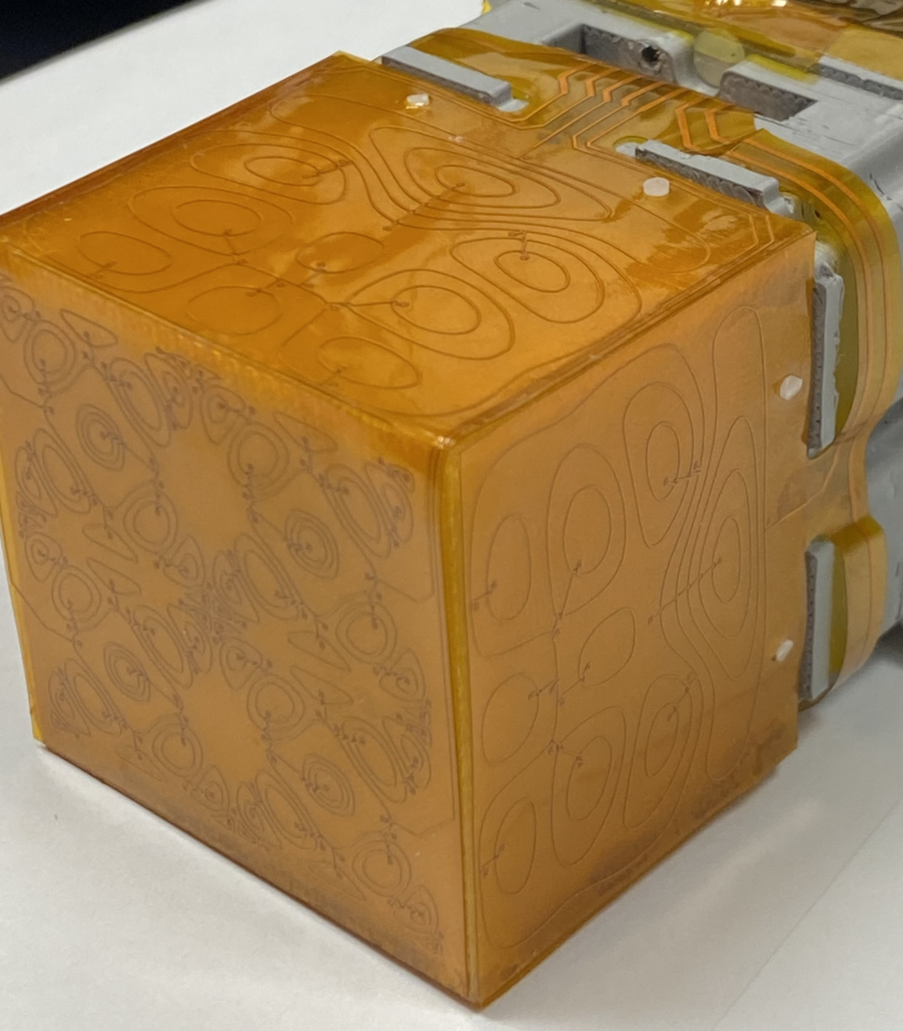
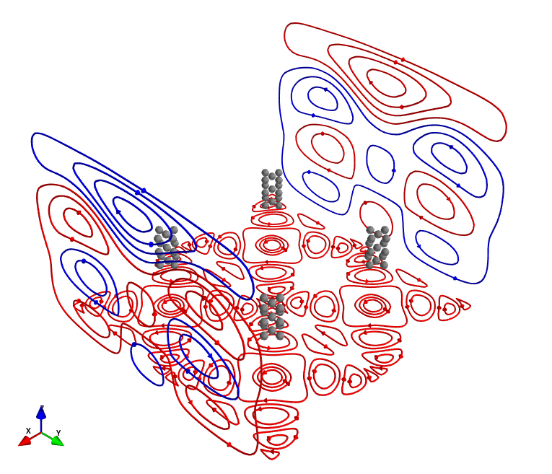
On-Sensor coils for the Gen 2 Sensor
Designed by Joonas Iivanainen with bfieldtools
Coils:
  X: 2 coils
  Y: 2 coils
  Z: 4 coils
Channel
Locations

