Slide 1
WOPM 2024 TUTORIAL
Samu Taulu
Department of Physics, University of Washington
Institute for Learning and Brain Sciences, University of Washington

Slide 2
Outline
General-level differences between SQUID-MEG and OPM-MEG in the following areas:
  Interference suppression with magnetic field expansions
  Calibration
  Head movement issues, especially considering infant measurements
Some recommendations for coping with OPM-specific issues regarding the above topics

Slide 3
Interference suppression
Several existing methods such as basic filtering or signal space projection (SSP) can be applied to SQUID-MEG and OPM-MEG without major modifications
Application of the signal space separation (SSS) method may require some adjustment in order to apply it to OPM-MEG optimally

Slide 4
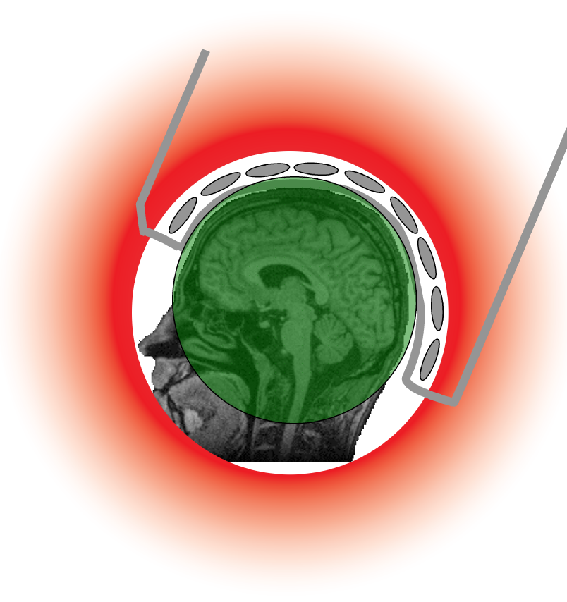




The Vector Spherical Harmonic (VSH) expansion
Signal Space Separation (SSS): Truncate the
internal and external expansions, solve for
the multipole moments and only keep the
internal ones. Dimensionality of the model
n = (L_{in} + 1)² + (L_{out} + 1)² – 2.
OPM systems potentially allow for a higher
truncation order than SQUIDs
Taulu and Kajola, J. Appl. Phys., 2005

Slide 5
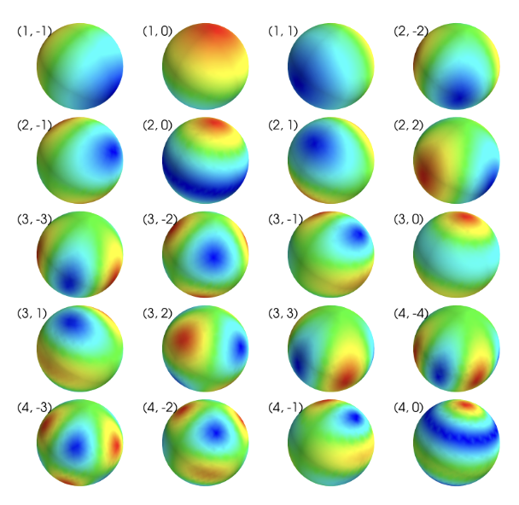
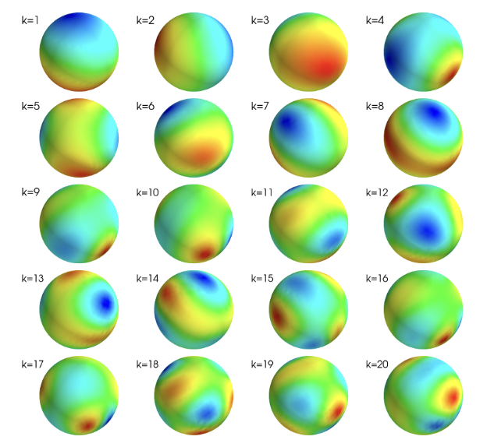
Spatial frequency hierarchy of the quasi-static magnetic field
First 20 VSH components for the
corresponding (l,m) values. The
plots are individually scaled.
Field components corresponding to
the most significant left singular vectors
of the singular value decomposition of
the lead field matrix. The plots are
individually scaled.

Slide 6
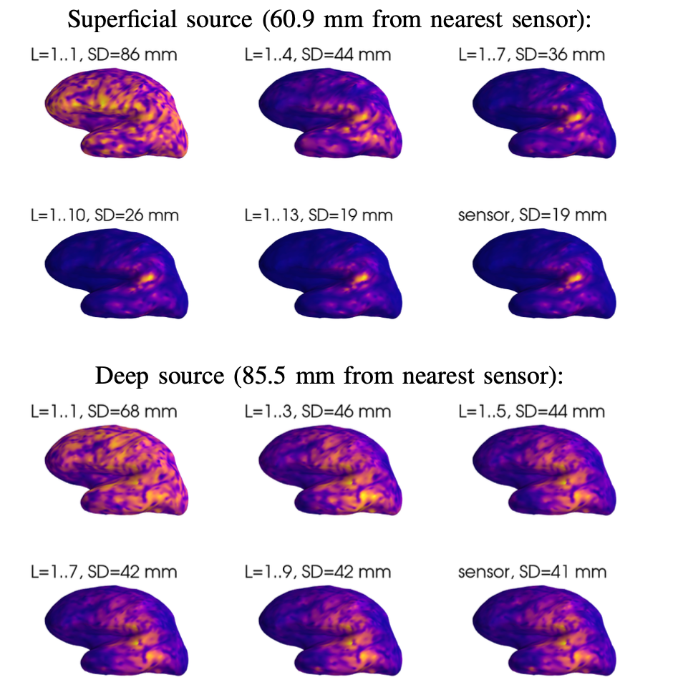
Resolution of the inverse problem as a function of the internal VSH truncation order
Internal and external truncation orders
of L_{in} = 13 and L_{out} = 3 correspond
to 210 degrees of freedom ->
probably at least ~400 – 500 sensors
needed for robust detection of the
internal/external spatial frequency
spectrum.
Notes:
Robustness can be improved by the iterative pinv

Slide 7
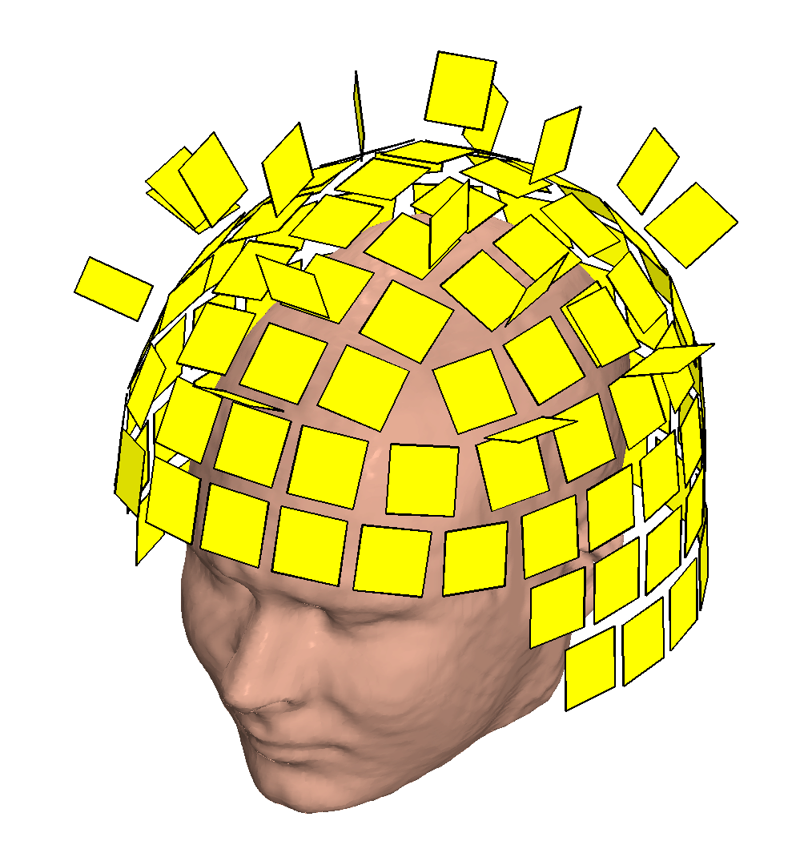
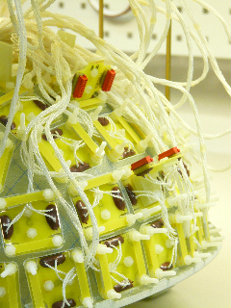
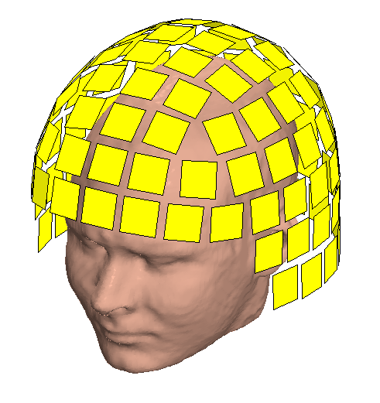
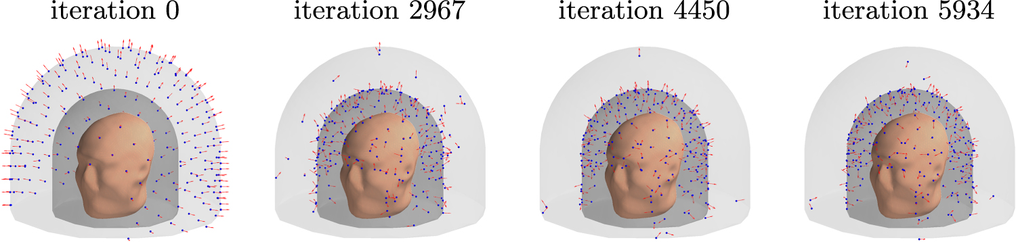
Sensor geometry affects the robustness of the detection of VSH components
Goal: minimize the
condition number of the SSS matrix ->
decrease reconstruction noise
306-channel SQUID
geometry
360-channel ”symmetry
Breaking” SQUID geometry
Nurminen et al., IEEE Trans. Biomed. Eng., 2013
Zhdanov et al., Phys. Med. Biol, 2023

Slide 8
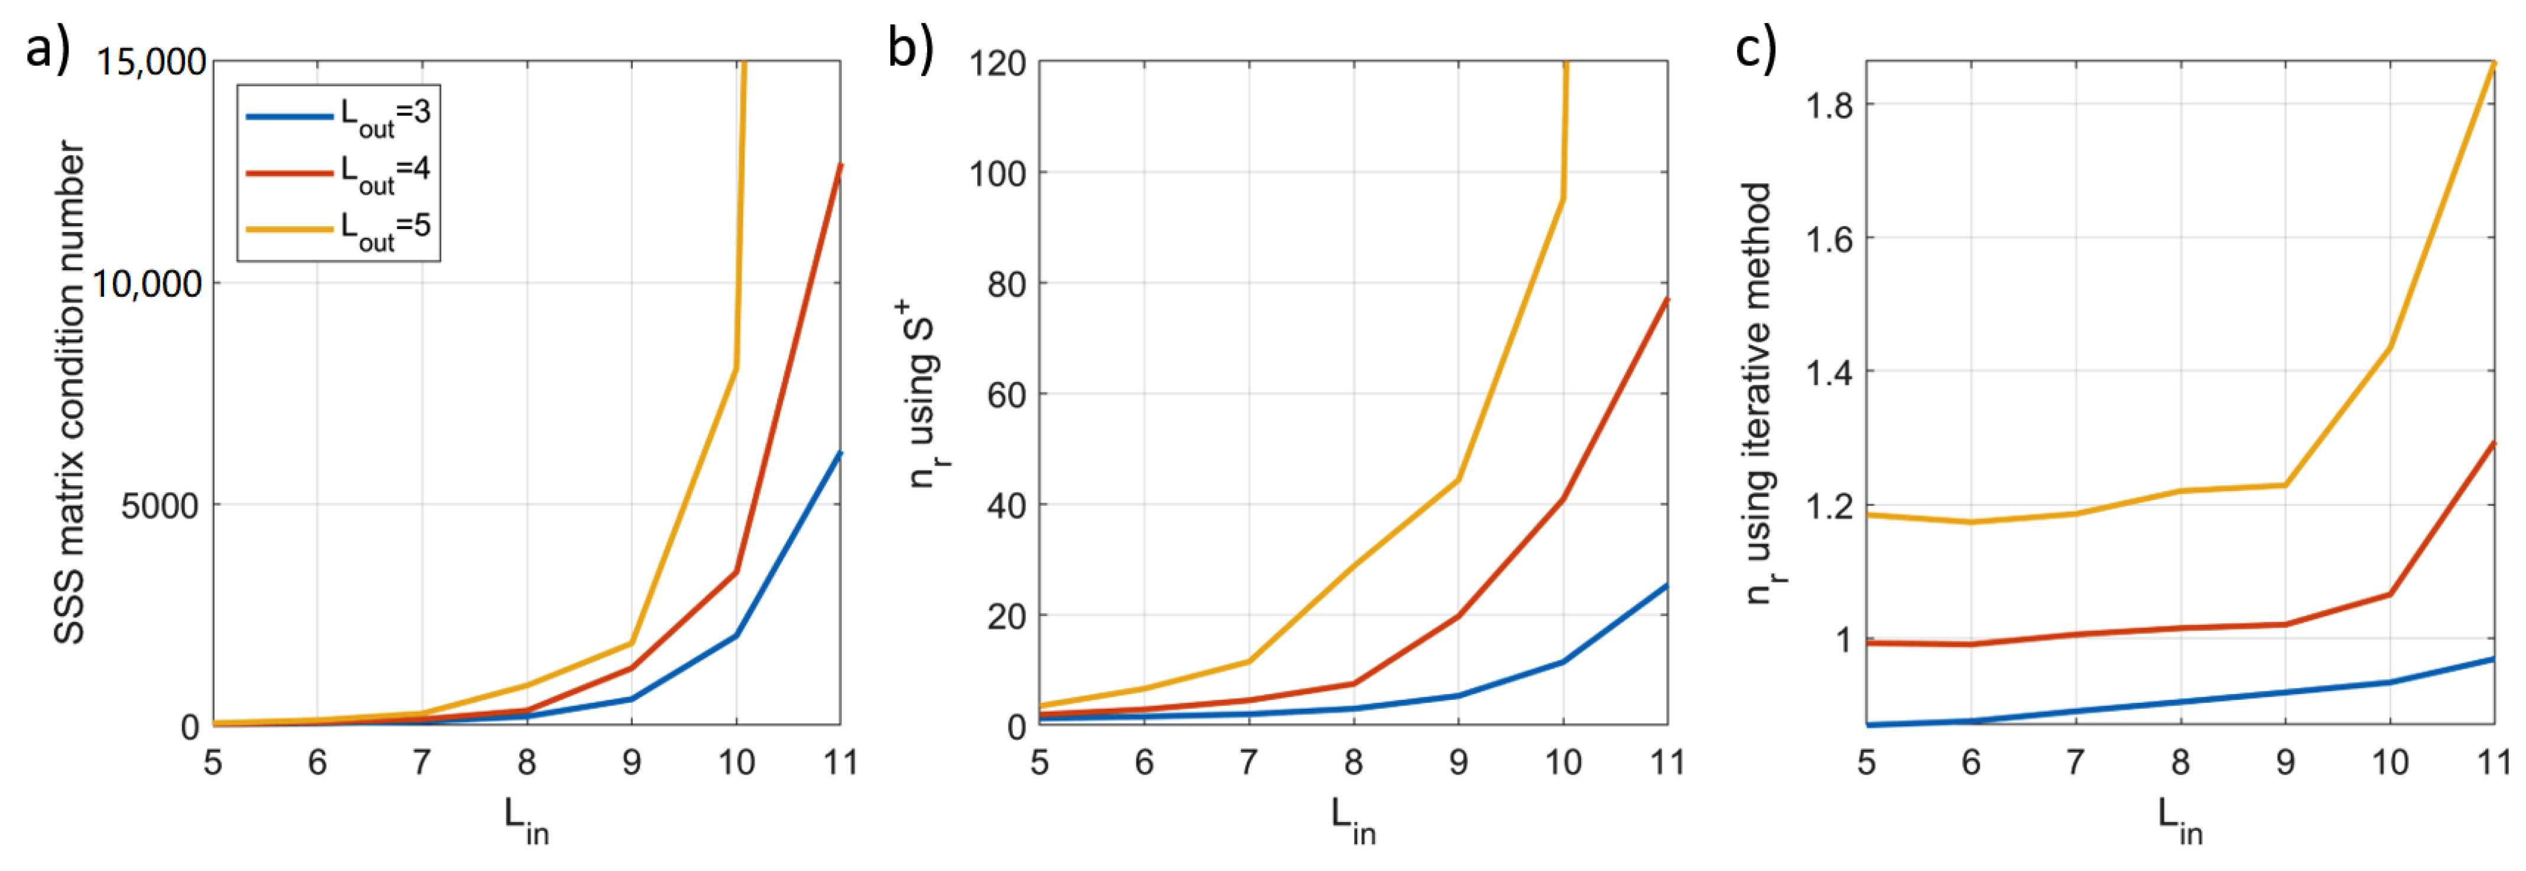
Iterative pseudo-inverse for low channel-count systems
Relative reconstruction
noise as a function matrix
dimension
Condition number of the
full SSS basis
Relative reconstruction
noise as a function matrix
dimension
Relative reconstruction
noise as a function matrix
dimension with the iterative
method
Unstable SSS matrix leads to elevated sensor noise.
The SSS matrix inversion can be performed iteratively for
different L_{in} orders, leading to a much more stable estimate.
Holmes et al., Sensors, 2023.
Notes:
- 192 channels?

Slide 9
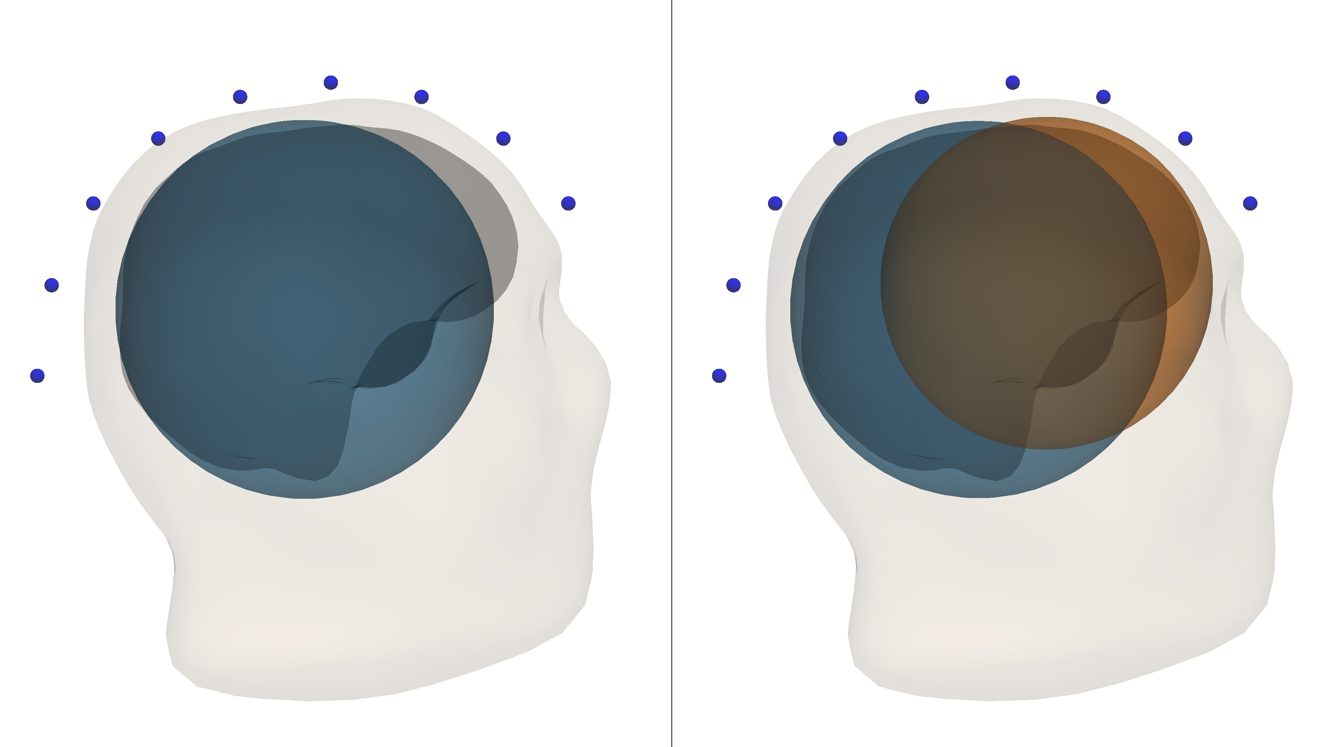
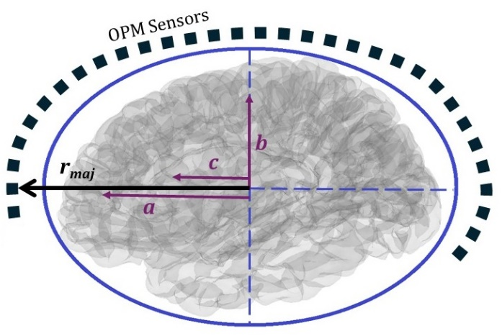
Modification of the expansion needed for OPMs?
Basic VSH expansion may
not cover all of the brain
for on scalp-MEG
Multi-origin VSH
(McPherson et al., in preparation)
Prolate spheroidals
(Tierney et al., Hum. Brain Mapp., 2024)

Slide 10
Artifact sources very close to the sensors
Artifacts generated by sources such as dental braces or vagal nerve stimulators (VNS) can be quite routinely suppressed by the spatiotemporal signal space separation (tSSS) method
The high dynamic range of SQUID sensors is helpful in this respect
Such artifacts pose a great challenge in OPM measurements due to dynamic rage and cross-axis projection error concerns

Slide 11
Calibration
Accurate calibration of the system needed for accurate forward and inverse modeling
Accurate calibration is also a requirement for efficient SSS processing
OPM-MEG systems may be able to see more clearly into the brain -> they also see calibration and modeling errors more clearly
Thus, overall better calibration accuracy needed to leverage the potential of OPM-MEG

Slide 12
Approaches to calibration
Use a precisely known calibration source, e.g., the phantom head
  Calibration depends on accurate information on the source geometry
Use a known calibration source, e.g., field compensation coils outside the MEG array
  Calibration does not need accurate information on the source geometry
Only require compliance of the MEG measurement with quasi-static Maxwell’s equations in general
  This is the “fine calibration” method applied in the Maxwell Filter software (MNE-Python)

Slide 13
Calibration of SQUID vs. OPM systems
SQUID arrays are static and basically only need to be calibrated once
  Information stored in a system-specific file (MEGIN systems)
OPM systems may potentially offer more flexibility and require calibration separately for each measurement session
Typical calibration parameters include sensor positions, orientations, scalar gain coefficients, and crosstalk coefficients
Cross-axis projection error may complicate OPM calibration

Slide 14
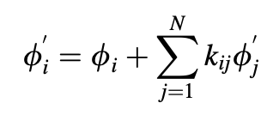



Example: linear calibration parameters
Crosstalk distortion of and individual sensor:
Crosstalk distortion as a linear algebra model:
Correcting for crosstalk if coefficients are known
Taking relative gain errors into account as well:

Slide 15
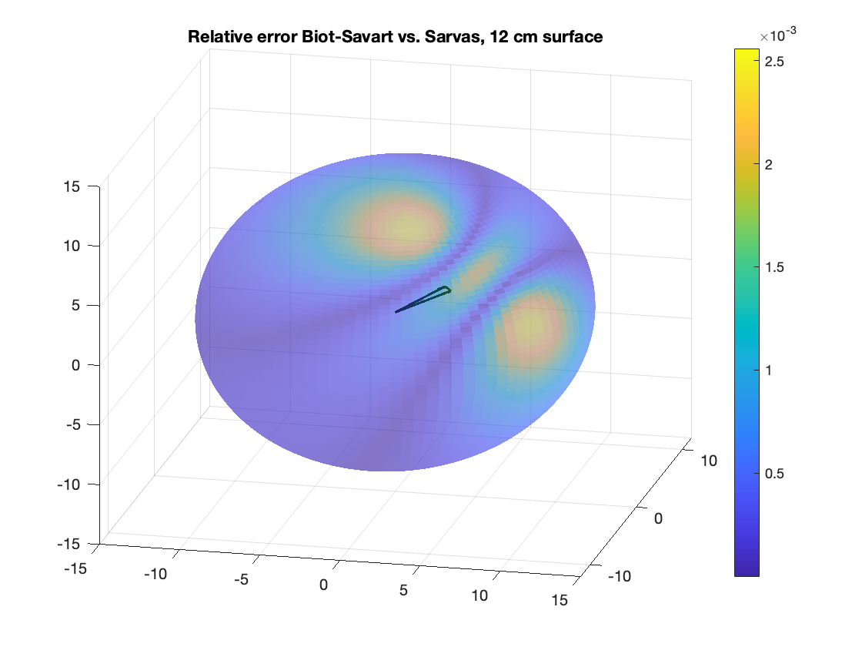
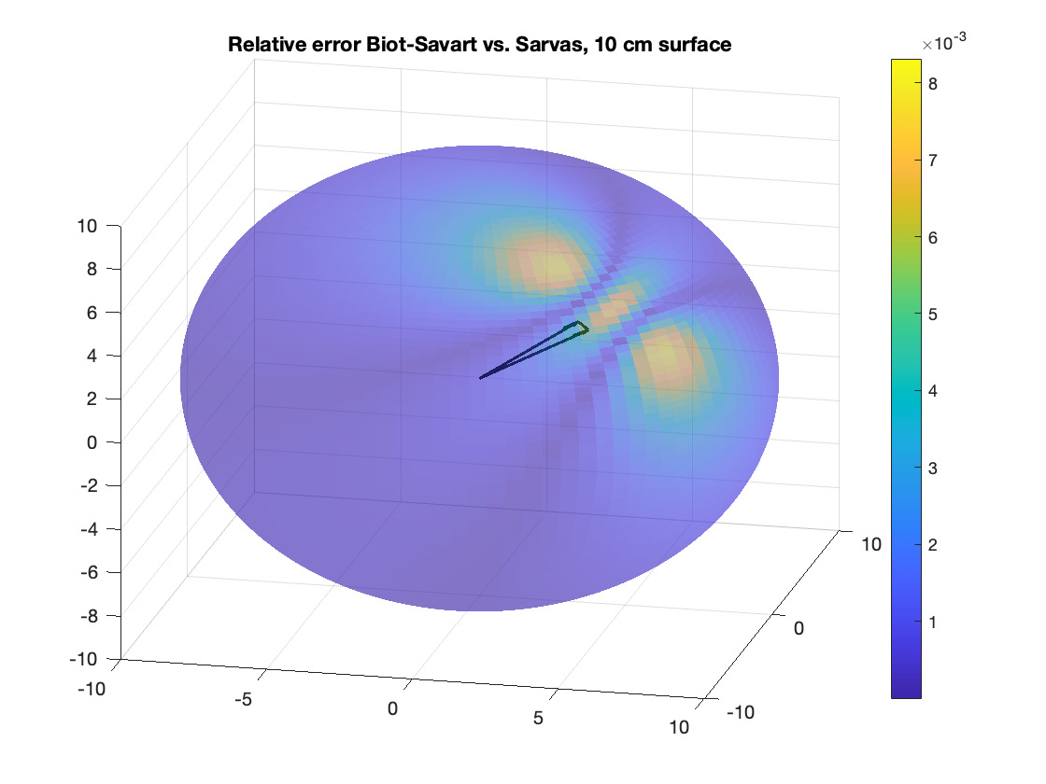
Phantom head: artificial current dipoles for calibration
Notes:
Show the current triangle and Brighton’s results here

Slide 16
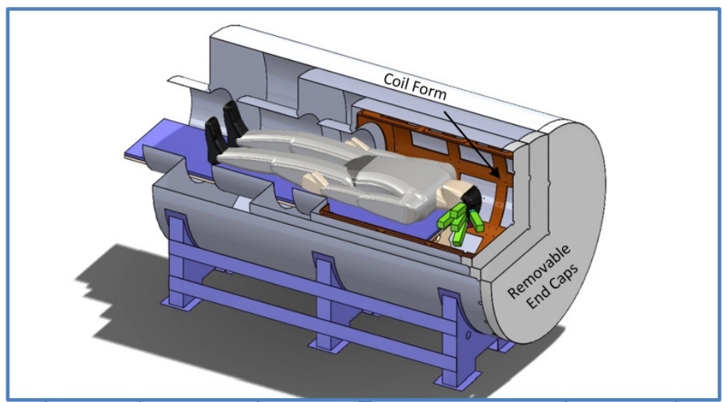
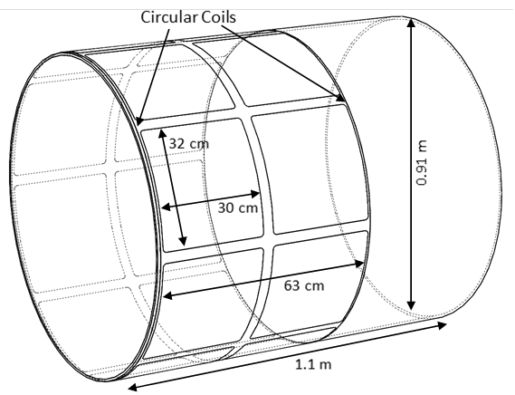
Using compensation coils for calibration
Use calibrated fluxgate sensors to measure the field
Extract the vector spherical harmonic (VSH) components up to a certain order l
Iivanainen et al., Sensors, 2022.

Slide 17
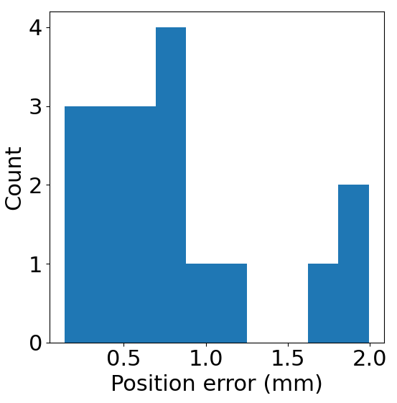
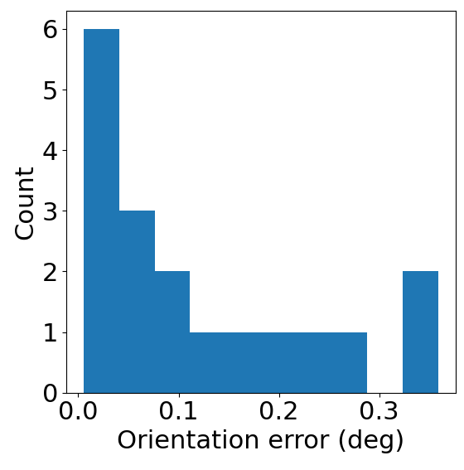
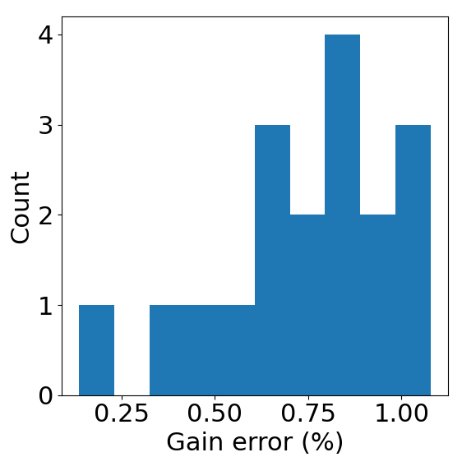
Validation of the method
Mean = 0.8 mm
Mean = 0.1°
Mean = 0.8%
Place three-axis fluxgates inside the sensor array
Use the algorithm to find the fluxgate parameters
Six positions inside the sensor array
  6×3 = 18 measurements (or sensors to calibrate)
The gains and relative positions/orientations of the fluxgate channels are known

Slide 18
Head movement issues in SQUIDs and OPMs
In SQUID systems, head movements are restricted to the interior of the fixed-size helmet
Head movements with respect to static sensors cause field distortions that can be compensated for
However, SQUID arrays do not allow for naturalistic movements
OPM arrays can be wearable and moveable but movement through the background DC field causes a different kind of a movement distortion

Slide 19
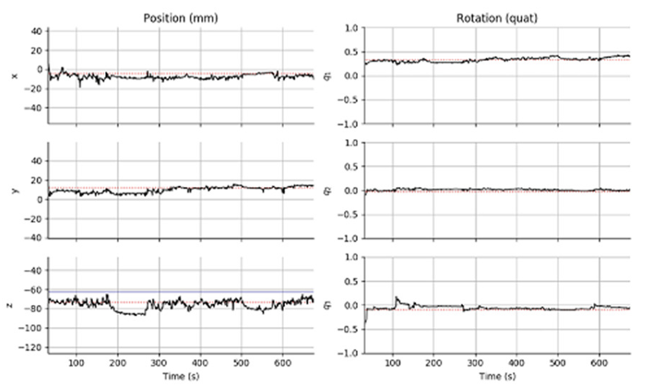
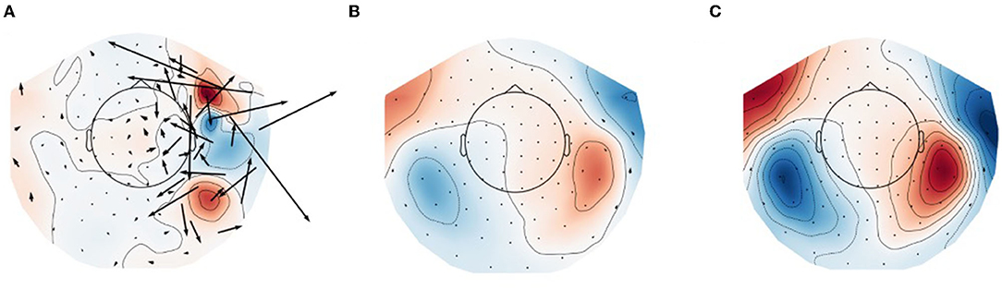
Infant head movements and compensation (SQUID measurements)
Larson and Taulu, Brain Topography, 2017
Original auditory
response
tSSS-processed
response
tSSS + movement
Compensated response
Clarke et al., Hum. Brain Mapp., 2022
Notes:
Show results from Maggie’s paper

Slide 20
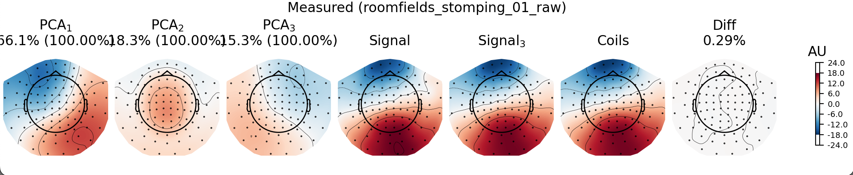
Moving sensor array
Movement of the MEG sensors in a background field creates (spatially smooth) artifacts
Field compensation necessary to avoid saturation and to minimize cross-axis projection errors
Notes:
Show Eric’s results here

Slide 21
Main challenges in infant MEG
SQUID:
  Behavioral (we don’t want the subjects to escape the helmet)
  Signal-to-noise ratio varies as a function of head position
OPM:
  Behavioral (do infants tolerate the confined sensor array?)
  Efficient dynamic field compensation needed for abrupt head movements
Overall, the main challenges are behavioral
  It is of utmost importance to keep the infants content during the recording
Notes:
Show results from my and Eric’s paper on head movements

Slide 22
Conclusions
Number of sensors and optimization of array geometry should be revisited for OPM-MEG
SSS processing may need adjustments: truncation order, convergence geometry, and numerical stabilization
Accuracy of calibration becomes increasingly critical and efficient methods for repeated calibration are needed
Movement distortion mechanisms are fundamentally different for SQUID-MEG and OPM-MEG. For the latter, dynamic background field compensation is necessary.

